Slide 1
Composting and Food Sustainability
Education Curriculum
Middle School Program
MAINE DEPARTMENT OF ENVIRONMENTAL PROTECTION
Protecting Maine’s Air, Land and Water

Slide 2
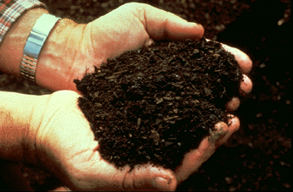
Compost
Compost looks and feels like fertile garden soil.
This dark, crumbly, earthy-smelling stuff works wonders on all kinds of soil and provides vital nutrients to help plants grow and look better.
Notes:
https://www.nrcs.usda.gov/wps/portal/nrcs/detail/national/newsroom/features/?&cid=nrcs143_023537
Photo: http://www.lancasterconservancy.org/wp-content/uploads/2016/07/Comsosting-image-1.gif

Slide 3
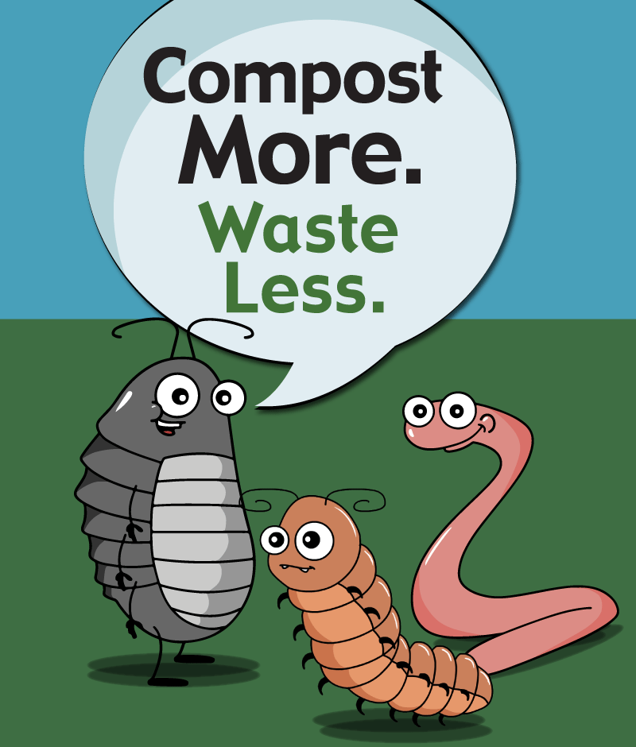
Compost
Decomposing organisms consist of bacteria, fungi, and larger organisms such as worms, sow bugs, nematodes, and numerous others.
Decomposing organisms need four key elements to thrive:
  Nitrogen
  Carbon
  Moisture
  Oxygen
Notes:
Nematode
any unsegmented worm of the phylum Nematoda, having an elongated, cylindrical body; a roundworm.
Sow Bugs
any of several small, terrestrial isopods, especially of the genus Oniscus; wood louse.
https://www.nrcs.usda.gov/wps/portal/nrcs/detail/national/newsroom/features/?&cid=nrcs143_023537
Photo: https://unclejimswormfarm.com/wp-content/uploads/2015/11/handful.jpg

Slide 4
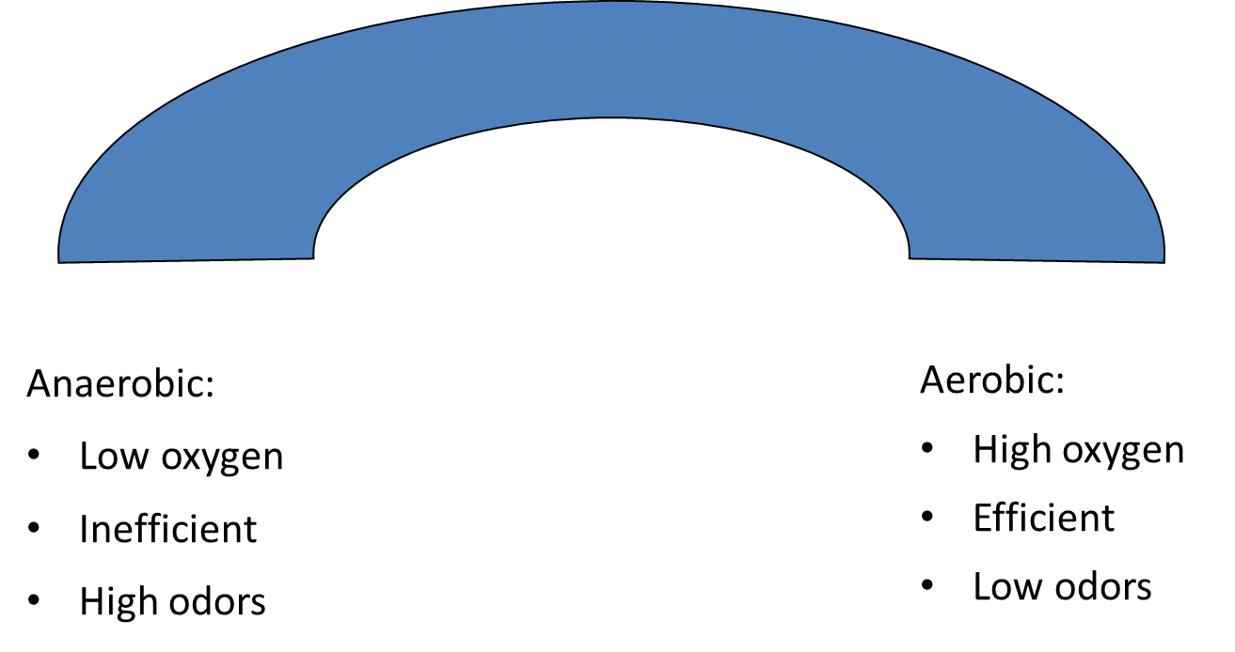

Anaerobic vs Aerobic Composting
Notes:
Anaerobic composting decomposes waste without oxygen. Anaerobic composting takes several years and typically happens in landfills. In Anaerobic composting, organic materials are piled up and break down naturally. This process does not need any type of maintenance and will not need to be turned. Anaerobic composting produces a large amount of methane and can be exceptionally pungent.
Aerobic composting uses oxygen and bacteria and replicates natural decomposition.
http://www.powerknot.com/2012/07/23/aerobic-composting-vs-anaerobic-composting/

Slide 5
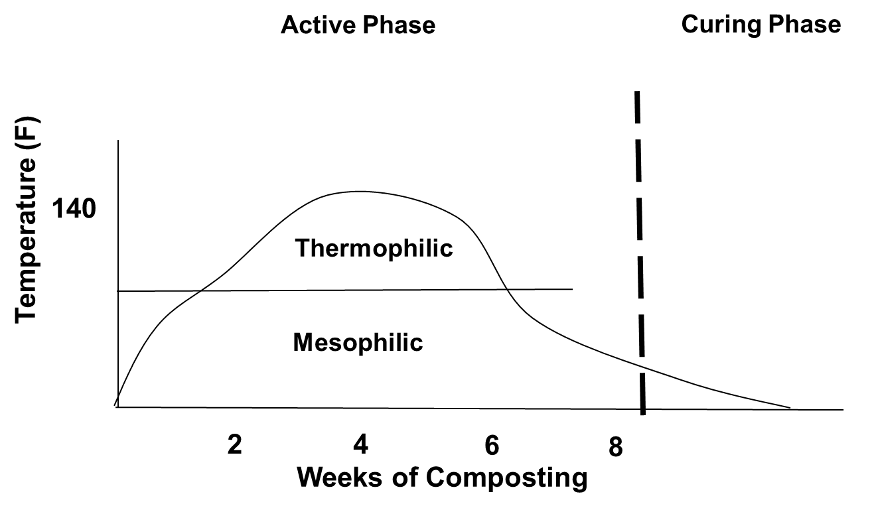
Phases of Aerobic Composting
Notes:
Mesophilic phase-Moderate temperatures (50-110oF) lasts for a few days. A mesophile is an organism that grows best in moderate temperature, neither too hot nor too cold, typically between 20 and 45 °C (68 and 113 °F).
Thermophilic phase-High temperatures (110-160o F) lasts for 4-6 weeks. A thermophile is an organism—a type of extremophile—that thrives at relatively high temperatures, between 41 and 122 °C (106 and 252 °F).
Curing and Maturation phase-Temperature moderate down to ambient lasts for 3-6 months

Slide 6
Oxygen Content
Need oxygen for most efficient process
21% oxygen in air
5%-10% is optimal for compost process
  <5% process slows remarkably
As pile heats more oxygen will be consumed by microbes

Slide 7
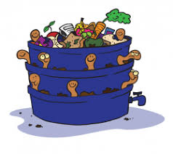
Another Way to Look at Composting
All composting requires three basic ingredients:
  Browns - This includes materials such as dead leaves, branches, and twigs.
  Greens - This includes materials such as grass clippings, vegetable waste, fruit scraps, and coffee grounds.
  Water.
Having the right amount of water, greens, and browns is important for compost development.
Notes:
Your compost pile should have an equal amount of browns to greens. You should also alternate layers of organic materials of different-sized particles. The brown materials provide carbon for your compost, the green materials provide nitrogen, and the water provides moisture to help break down the organic matter.
https://www.epa.gov/recycle/composting-home

Slide 8
So…What is a C:N Ratio?
(Brown : Green Ratio)
Supply of total carbon compared to total nitrogen in compost feedstock
If C:N is too high the compost process will slow
If C:N is too low, more likely to lose nitrogen as ammonia gas or in leachate
Ideal initial C:N mixture range is 20 – 30:1
Notes:
Leachate - water that has percolated through a solid and leached out some of the constituents.

Slide 9
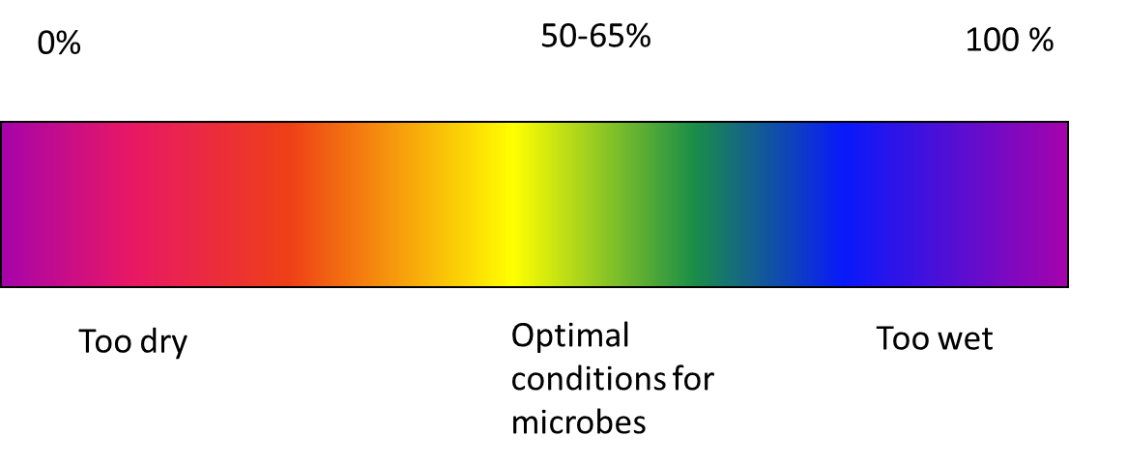
Compost Moisture
Notes:
Free moisture is needed on particle surfaces as a medium for bacteria
Free moisture is needed for nutrients to be in solution so they can be absorbed
Low moisture inhibits microbial growth and activity
High moisture content may result in anaerobic conditions due to saturation of pore spaces.

Slide 10
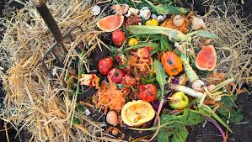
What to Compost
Fruits and vegetables – Eggshells - Coffee grounds and filters - Tea bags - Nut shells - Shredded newspaper - Cardboard – Paper - Yard trimmings - Grass clippings - Houseplants - Hay and straw – Leaves – Sawdust - Wood chips - Cotton and Wool Rags - Dryer and vacuum cleaner lint - Hair and fur - Fireplace ashes
Notes:
https://www.epa.gov/recycle/composting-home
Photo: rodalesorganiclife.com

Slide 11
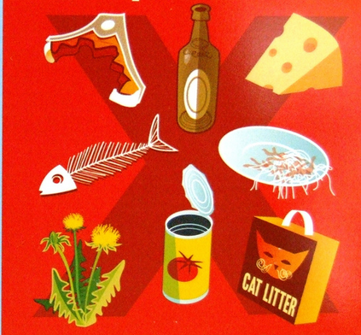
What Not to Compost
Black walnut tree leaves or twigs
Coal or charcoal ash
Dairy products
Diseased or insect-ridden plants
Fats, grease, lard, or oils
Meat or fish bones and scraps
Pet wastes
Yard trimmings treated with chemical pesticides
Notes:
Black walnut tree leaves or twigs - Releases substances that might be harmful to plants
Coal or charcoal ash - - Might contain substances harmful to plants
Dairy products - - Create odor problems and attract pests such as rodents and flies
Diseased or insect-ridden plants - - Diseases or insects might survive and be transferred back to other plants
Fats, grease, lard, or oils - - Create odor problems and attract pests such as rodents and flies
Meat or fish bones and scraps - - Create odor problems and attract pests such as rodents and flies
Pet wastes - - Might contain parasites, bacteria, germs, pathogens, and viruses harmful to humans
Yard trimmings treated with chemical pesticides - - Might kill beneficial composting organisms
Figure: www.recyclenow.com/compost
https://www.epa.gov/recycle/composting-home

Slide 12

Benefits of Composting
Enriches soil, helping retain moisture and suppress plant diseases and pests.
Reduces the need for chemical fertilizers.
Encourages the production of beneficial bacteria and fungi that break down organic matter to create humus, a rich nutrient-filled material.
Reduces methane emissions from landfills and lowers your carbon footprint.
Notes:
https://www.epa.gov/recycle/composting-home

Slide 13
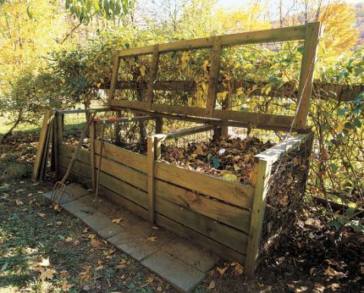
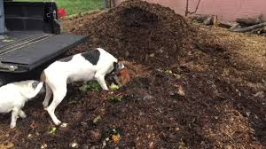
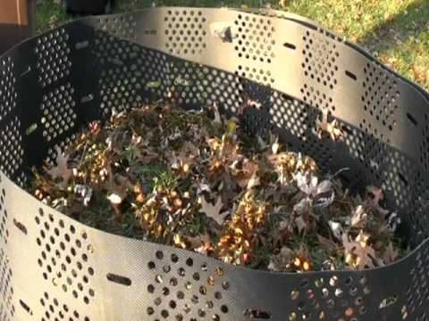
Backyard Composting
Select a dry, shady spot near a water source for your compost pile or bin.
Add brown and green materials as they are collected, making sure larger pieces are chopped or shredded.
Moisten dry materials as they are added.
Once your compost pile is established, mix grass clippings and green waste into the pile and bury fruit and vegetable waste under 10 inches of compost material.
Notes:
Optional: Cover top of compost with a tarp to keep it moist. When the material at the bottom is dark and rich in color, your compost is ready to use. This usually takes anywhere between two months to two years.
https://www.epa.gov/recycle/composting-home Photos youtube, Pinterest

Slide 14
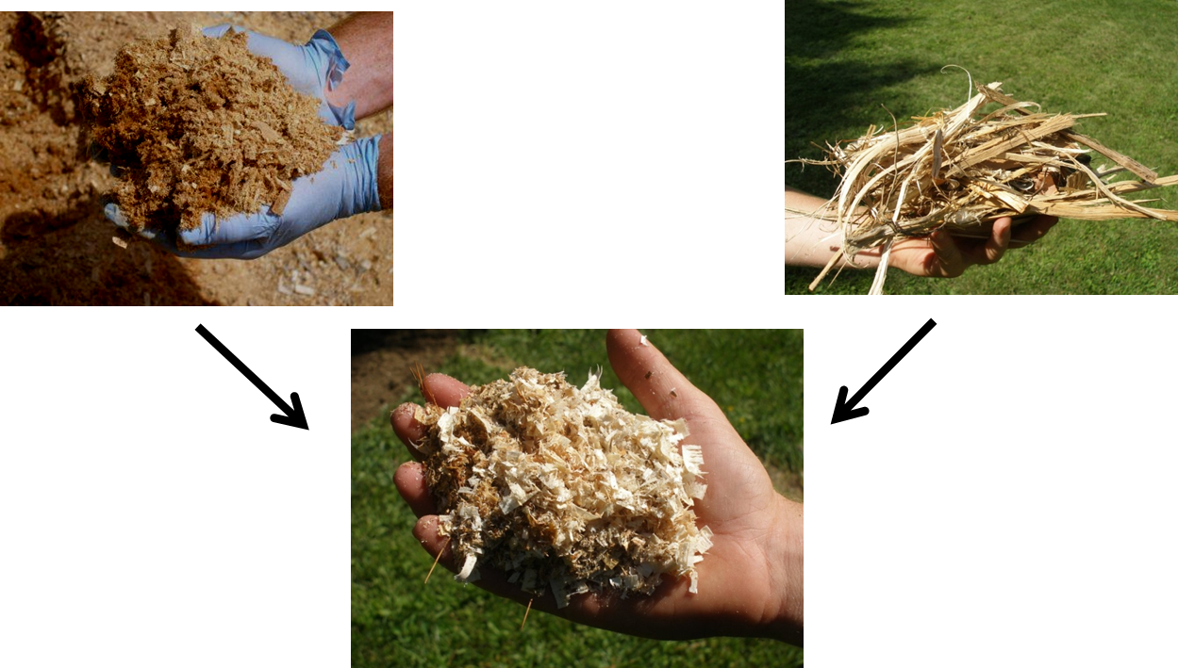
Does Texture Really Matter?

Slide 15
Indoor Composting
If you do not have space for an outdoor compost pile, you can compost materials indoors using a special type of bin, which you can buy at a local hardware store, gardening supplies store, or make yourself.
Remember to tend your pile and keep track of what you throw in.
  A properly managed compost bin will not attract pests or rodents and will not smell bad.
  Your compost should be ready in two to five weeks.
Notes:
https://www.epa.gov/recycle/composting-home

Slide 16
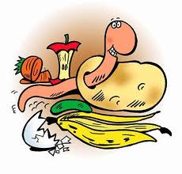
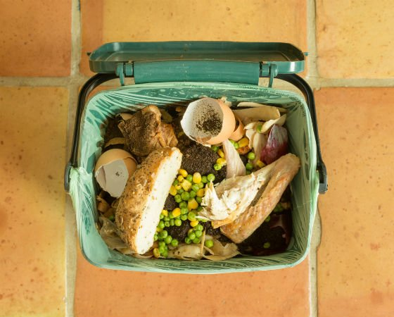
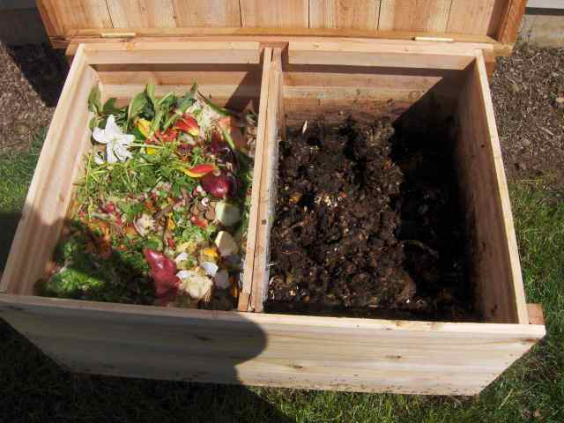
Compost Bins
Indoor Compost Bin
Outdoor Compost Bin
Notes:
Photo: indoor composting: https://s3-production.bobvila.com/articles/wp-content/uploads/2017/09/Indoor_Composting_101.jpg
Outdoor compost bin: left: http://macrobonsai.com/wp-content/uploads/como-hacer-compost-de-lombrices.jpg

Slide 17
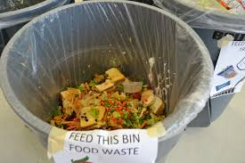
Consider Reducing Food Waste
Wasted food is a social problem
Wasted food is an environmental problem
Wasted food is an economic issue
Notes:
Wasted food is a social problem: In 2013, 14.3 percent of U.S. households were food insecure at some time during the year. That is 48 million Americans, of which 16 million are children, living in food insecure households. Wholesome, nutritious food should feed people, not landfills.
Wasted food is an environmental problem: Food is the largest stream of materials in American trash. Once wasted food reaches landfills, it produces methane, a powerful greenhouse gas.
Wasted food is an economic issue: It is estimated that at the retail and consumer levels in the United States, food loss and waste totals $161 billion dollars.
Source: https://www.epa.gov/sustainable-management-food/food-too-good-waste-implementation-guide-and-toolkit#whyis
Photo: https://erefdn.org/wp-content/uploads/2016/06/DSC_0842.jpg

Slide 18
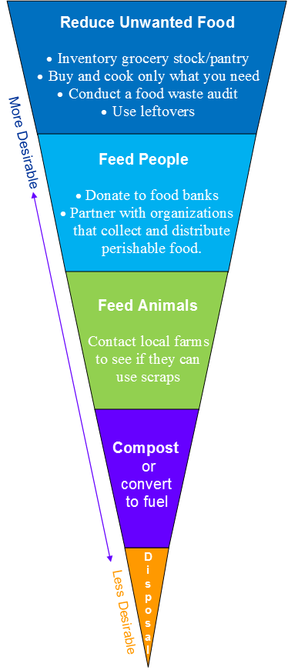
Notes:
Most preferred activities are at the top; least preferred as you move down the triangle.
Source: Maine DEP

Slide 19
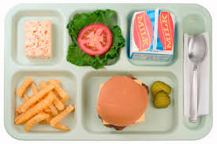
Food Loss Prevention Options for Your School
□ Perform a food waste audit.
□ Set up a share table.
□ Employ “Offer versus Serve.”
□ Schedule recess before lunch.
□ Extend lunch periods from 20 to 30 minutes to reduce plate waste by nearly one-third.
□ Minimize waste from mandatory fruit and vegetable servings.
Notes:
Below is a list of ideas and activities that grade schools may consider implementing to help prevent food loss and waste. Contact your local EPA representative for log sheets, signs, and other tools. □ Perform a food waste audit. See what’s being thrown out and why. o Get the students involved. Be there at the dish return line with a few volunteers, buckets, a log sheet and a weight scale. Record what and how much is being thrown out and why. Be sure to ask students for reasons why they didn’t finish their food. o In the kitchen, have only one food waste trash can and provide each staff member a small container to fill with food waste at their station. Before they empty their container, have staff weigh it and record the amount, type and reason the waste is being discarded on a log sheet located near the trash can. o Audit Tip: Volunteering can be part of the core curriculum or count toward community service hours for many student organizations. □ Set up a share table. Check with your local health department and school board to find out if donating and sharing is allowed. If so, set up a share table, a place students can return whole items that they choose not to eat so that they are available for others who may want additional helpings. □ Employ “Offer versus Serve.” Offer versus Serve is a provision in the U.S. Department of Agriculture’s (USDA) National School Lunch Program and their School Breakfast Program that allows students to decline some of the food offered that they do not intend to eat to help reduce food waste. □ Schedule recess before lunch. This strategy shows a reduction of plate waste and an increase in food and nutrient consumption. □ Provide children another choice of beverage in the food service line that is low cost for the school (e.g., water). □ Extend lunch periods from 20 to 30 minutes to reduce plate waste by nearly one-third. □ Minimize waste from mandatory fruit and vegetable servings. Many schools are required to offer or serve a fruit/vegetable serving to students. Below are tips to reduce waste associated with this requirement: o Slice the fruit: Cutting fruit into bite-sized pieces is easier to eat and encourages students to eat what is on their trays. o Give fruits and vegetables catchy names that appeal to children: Younger kids like fun names like “Xray Vision Carrots” and “Super Strength Spinach” while older children prefer more descriptive names like “Succulent Summer Corn” and “Crisp Celery and Carrots.” o Put healthy foods within reach: Moving salad bars and fruit closer to students' reach increases both sales and consumption.
https://www.epa.gov/sustainable-management-food/food-loss-prevention-options-grade-schools-manufacturers-restaurants

Slide 20
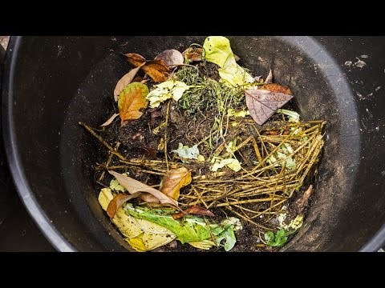
How To Make Compost - Easy Composting Tips (~ 5:49)
Notes:
YouTube: https://www.youtube.com/watch?v=q7LnBpJkuhs

Slide 21

Project
Can Anything Be Turned Into Compost?
Can a Food Sustainability Plan be Implemented at your School?
Notes:
https://criticallyrated.files.wordpress.com/2015/11/question-art.jpg

Slide 22

www.maine.gov/dep

