Slide 1
Environmental Regulations
Education Curriculum
High School Program
MAINE DEPARTMENT OF ENVIRONMENTAL PROTECTION
Protecting Maine’s Air, Land and Water
Notes:
Source 1: Environmental Law and Policy
Source 2: Principles of Environmental Engineering and Science
Others as noted.

Slide 2
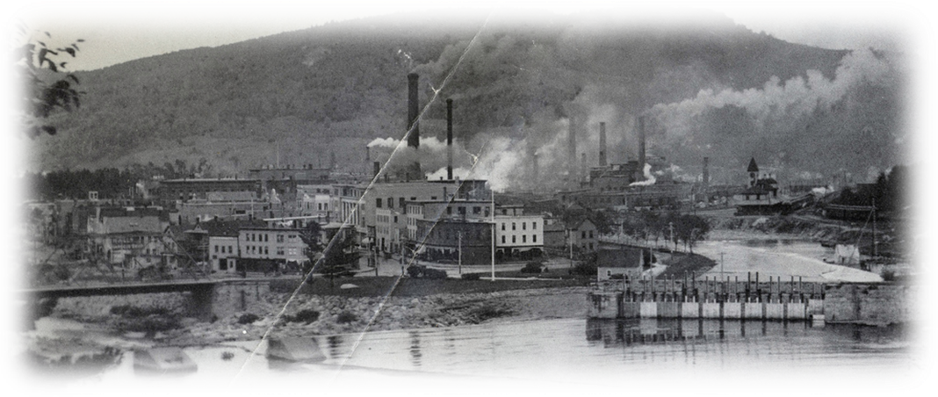

A Short History of Environmental Law
1600s-1890s
  Discharges of all forms of pollution are an established disposal practice
MAINE DEPARTMENT OF ENVIRONMENTAL PROTECTION www.maine.gov/dep
Notes:
https://www.northcountrypublicradio.org/news/images/IP_paper_mill_rumford.jpg – International Paper Mills, Rumford Falls, 1890s.

Slide 3
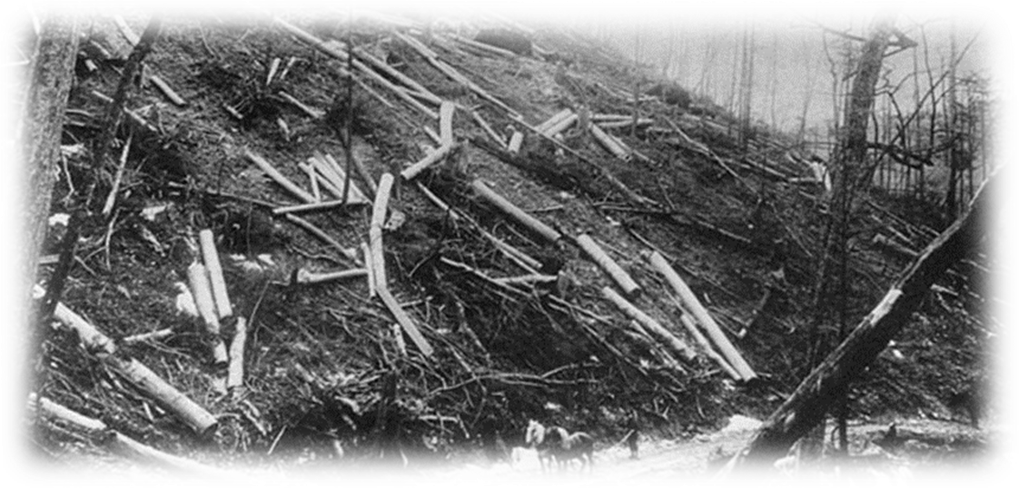
Late 1800s-1914
  Similar to prior practices
  Some authority to local health departments and U.S. Forest Service Rules on grazing and timber-cutting
MAINE DEPARTMENT OF ENVIRONMENTAL PROTECTION www.maine.gov/dep
Notes:
Photo: http://www.google.com/imgres?q=timber+cutting&um=1&hl=en&sa=N&biw=1366&bih=673&tbm=isch&tbnid=IGJlvSaw5dOHvM:&imgrefurl=http://www.jaha.org/edu/flood/why/img/lumber_gallery/pages/timber05.html&imgurl=http://www.jaha.org/edu/flood/why/img/lumber_gallery/images/timber05.jpg&w=700&h=336&ei=vVtHUNq2Iaj40gGX-4HICw&zoom=1&iact=hc&vpx=999&vpy=394&dur=1787&hovh=155&hovw=324&tx=197&ty=80&sig=114114391666442162333&page=2&tbnh=102&tbnw=213&start=17&ndsp=21&ved=1t:429,r:4,s:17,i:143

Slide 4
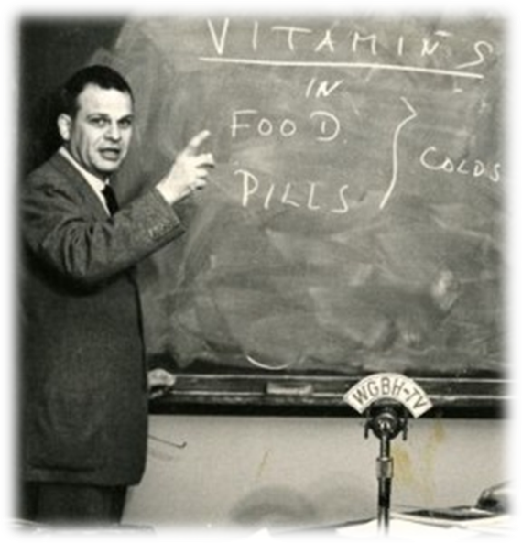
1914-1960s
  The Public Health movement gets underway with limited success
Notes:
Photo:
https://www.countway.harvard.edu/menuNavigation/chom/fphp.html

Slide 5
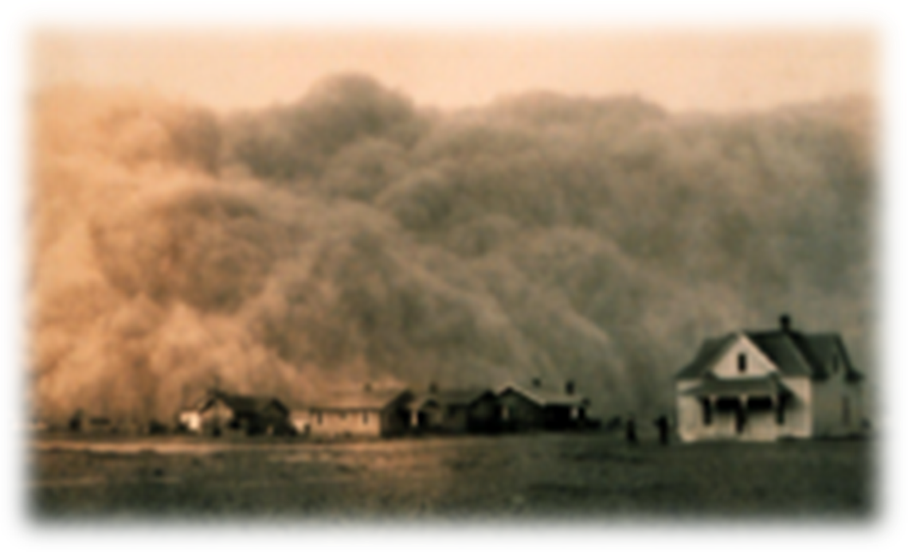
Dust Bowl in the 1930s
Notes:
The Dust Bowl, also known as the Dirty Thirties, was a period of severe dust storms that greatly damaged the ecology and agriculture of the American and Canadian prairies during the 1930s; severe drought and a failure to apply dryland farming methods to prevent wind erosion caused the phenomenon. The drought came in three waves, 1934, 1936, and 1939–1940, but some regions of the high plains experienced drought conditions for as many as eight years. With insufficient understanding of the ecology of the plains, farmers had conducted extensive deep plowing of the virgin topsoil of the Great Plains during the previous decade; this had displaced the native, deep-rooted grasses that normally trapped soil and moisture even during periods of drought and high winds.
Source: https://en.wikipedia.org/wiki/Dust_Bowl
Figure: http://en.wikipedia.org/wiki/Dust_Bowl

Slide 6
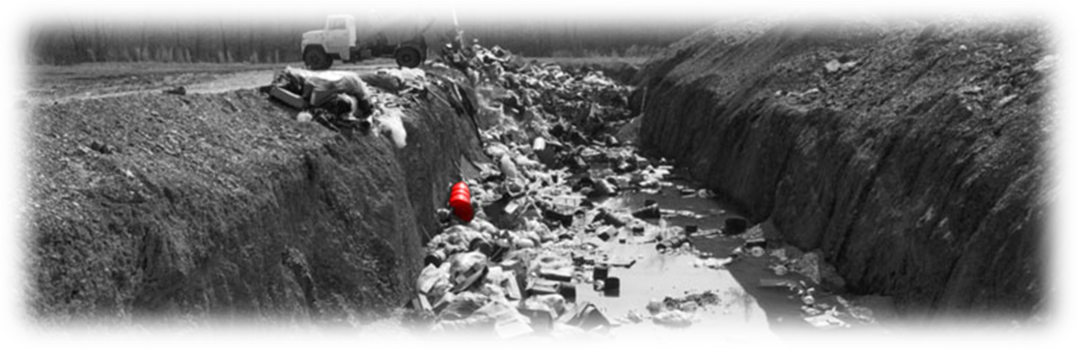
1950s
The first federal efforts to address air and water pollution came about in the 1950s
Notes:
http://www.justice.gov/enrd/3304.htm

Slide 7
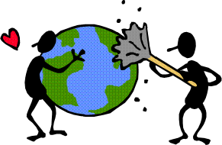
1960s-1970s
Johnson administration support substantive federal environmental regulations
    The Wilderness Act of 1964
      created the legal definition of wilderness in the United States, and protected some 9 million acres (36,000 km²) of federal land
Notes:
The Wilderness Act, signed into law in 1964, created the National Wilderness Preservation System and recognized wilderness as “an area where the earth and its community of life are untrammeled by man, where man himself is a visitor who does not remain.” The Act further defined wilderness as "an area of undeveloped Federal land retaining its primeval character and influence without permanent improvements or human habitation, which is protected and managed so as to preserve its natural conditions . . . ." Source: https://wilderness.nps.gov/faqnew.cfm
Congress has now designated more than 106 million acres of federal public lands as wilderness: 44 million of these acres are in 47 parks and total 53 percent of National Park System lands. Additional national park areas are managed as “recommended” or "proposed" wilderness until Congress acts on their status. Source: https://wilderness.nps.gov/faqnew.cfm
“Race to the Bottom” - a situation characterized by a progressive lowering or deterioration of standards, especially (in business contexts) as a result of the pressure of competition. Dictionary.com

Slide 8
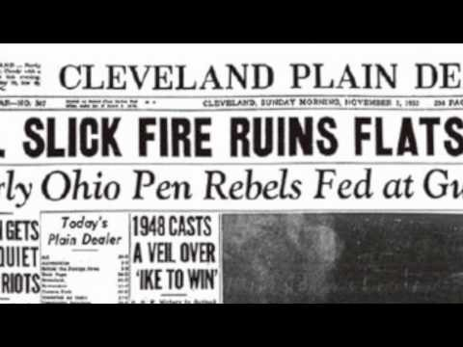
Cuyahoga River 1969
Don’t Fall in The River
Run Time ~1:24
Notes:
Source: https://www.youtube.com/watch?v=nlHiaZFvcXA

Slide 9
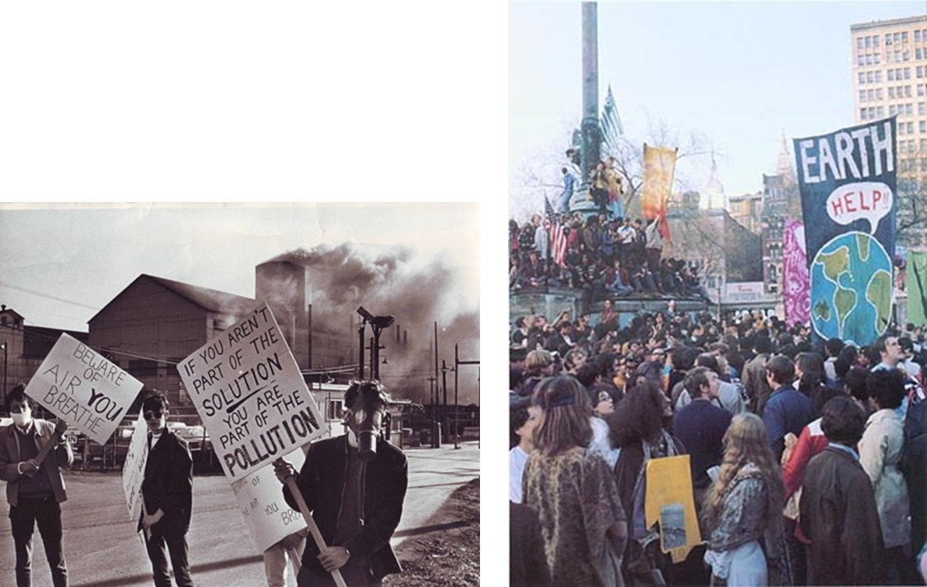
First Earth Day 1970
Notes:
Earth Day - The idea for a national day to focus on the environment came to Earth Day founder Gaylord Nelson, then a U.S. Senator from Wisconsin, after witnessing the ravages of the 1969 massive oil spill in Santa Barbara, California. Inspired by the student anti-war movement, he realized that if he could infuse that energy with an emerging public consciousness about air and water pollution, it would force environmental protection onto the national political agenda. Source: https://www.earthday.org/about/the-history-of-earth-day/
http://www.goodlifer.com/wp-content/uploads/2011/04/GL_EarthDay11_solutionpollution.jpg
http://planetforward.ca/blog/earth-day-2010-40th-anniversary-part-one-flashback-to-1970

Slide 10
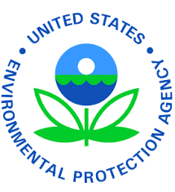
Environmental Protection Agency (EPA)
The EPA was established on December 2, 1970 to consolidate in one agency a variety of federal research, monitoring, standard-setting and enforcement activities to ensure environmental protection.
Since its inception, EPA has been working for a cleaner, healthier environment for the American people.
Notes:
President Richard Nixon proposed the establishment of EPA. The agency conducts environmental assessment, research, and education. It has the responsibility of maintaining and enforcing national standards under a variety of environmental laws, in consultation with state, tribal, and local governments.

Slide 11
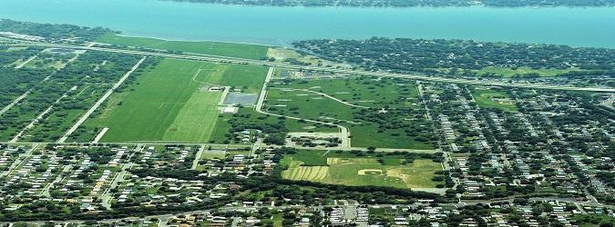
Pollution Incidents and Control
  Notorious Pollution Incidents
    Los Angeles Killer Smog
    New York State’s Love Canal neighborhood (shown below)
    PA’s Donora air pollution deaths
    VA’s Allied Chemical Kepone contamination
  Clean Air Act (CAA)
  Clean Water Act (CWA)
  Toxic control statutes
Notes:
These are discussed in more detail in the following slides. Photo: https://cumulis.epa.gov/supercpad/SiteProfiles/index.cfm?fuseaction=second.photovideoaudio&id=0201290#Photo

Slide 12
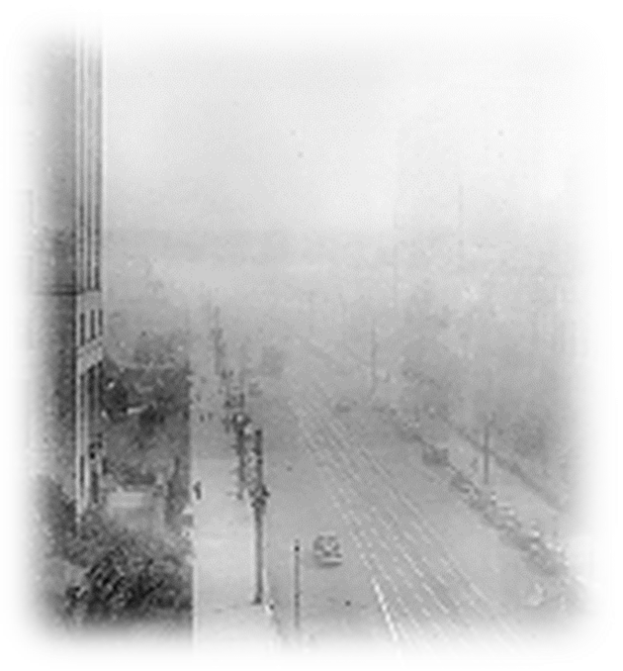
L.A. Killer Smog
1943
Visibility down to 3 blocks
Stinging eyes, throats burning
Notes:
http://www.aqmd.gov/news1/Archives/History/marchcov.html

Slide 13
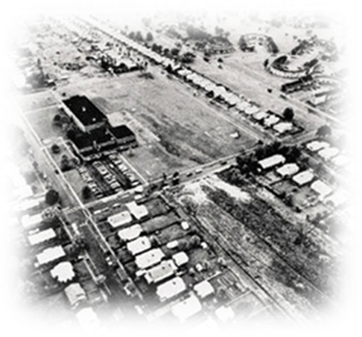
Love Canal
The Love Canal came from the last name of William T. Love, who in the early 1890s envisioned a canal connecting the Niagara River to Lake Ontario
He hoped to serve the area's burgeoning industries with much needed hydro electricity
By the 1940s, Hooker Electrochemical Company began searching for a place to dump the large quantity of chemical waste it was producing
Notes:
Love Canal is a neighborhood within Niagara Falls, New York. The neighborhood is infamously known as the host of a 70-acre landfill that served as the epicenter of a massive environmental pollution disaster that affected the health of hundreds of residents, culminating in an extensive Superfund cleanup operation.
Originally intended as a model planned community, Love Canal served as a residential area before being purchased by Hooker Chemical Company. After its sale to the local school district. Love Canal attracted national attention for the public health problem originated from the massive dumping of toxic waste on the grounds. This event displaced numerous families, leaving them with long-standing health issues and symptoms of high white blood cell counts and leukemia. Consequently, the federal government passed the Superfund law. The resulting cleanup operation under the Superfund law demolished the neighborhood, wrapping up in 2004.
Source: www.wikipedia.com

Slide 14
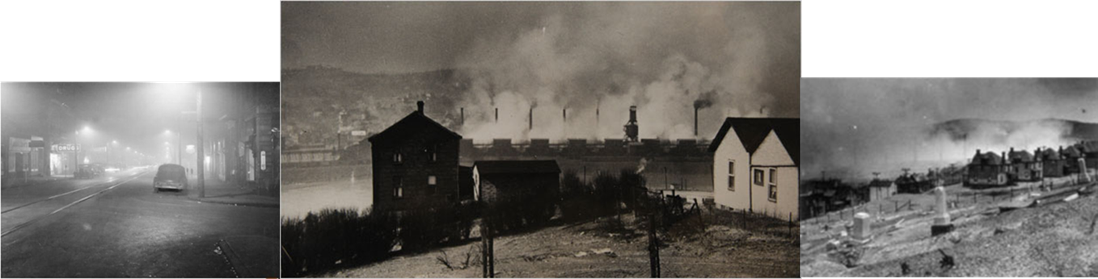
Donora Air Pollution Incident
The 1948 Donora smog was a historic air inversion resulting in a wall of smog that killed 20 people and sickened 7,000 more in Donora, Pennsylvania.
Notes:
The fog started building up in Donora on October 27, 1948. By the following day it was causing coughing and other signs of respiratory distress for many residents of the community in the Monongahela River valley. Many of the illnesses and deaths were initially attributed to asthma. The smog continued until it rained on October 31, by which time 20 residents of Donora had died and approximately one third to one half of the town's population of 14,000 residents had been sickened. Another 50 residents died of respiratory causes within a month after the incident. Hydrogen fluoride and sulfur dioxide emissions from U.S. Steel's Donora Zinc Works and its American Steel & Wire plant were frequent occurrences in Donora. What made the 1948 event more severe was a temperature inversion, a situation in which warmer air aloft traps pollution in a layer of colder air near the surface. The pollutants in the air mixed with fog to form a thick, yellowish, acrid smog that hung over Donora for five days. The sulfuric acid, nitrogen dioxide, fluorine, and other poisonous gases that usually dispersed into the atmosphere were caught in the inversion and accumulated until rain ended the weather pattern.
It was not until Sunday morning, the 31st of October, that a meeting occurred between the operators of the plants, and the town officials. Burgess Chambon requested the plants temporarily cease operations. The superintendent of the plants, L.J. Westhaver, said the plants had already begun shutting down operation at around 6 a.m. that morning. With the rain alleviating the smog, the plants resumed normal operation the following morning.
http://en.wikipedia.org/wiki/1948_Donora_smog http://www.metrolic.com/biggest-industrial-disasters-from-the-united-states-of-america-144393

Slide 15
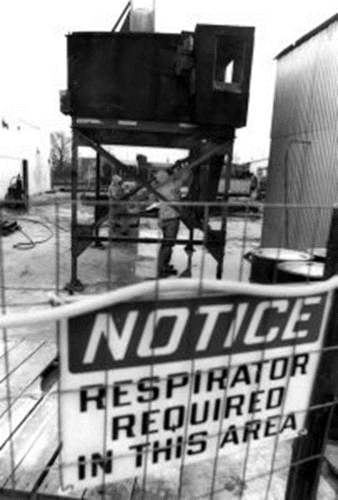
Allied Chemical & the Pesticide Keypone
Toxic Waste sent through the Hopewell sewage treatment plant into the James River.
  1961 FDA warned of the toxicity of the substance
  Dust present at the site
  Medical issues, brain/liver/memory/speech
Notes:
In the US, kepone was produced by Allied Signal Company and LifeSciences Product Company in Hopewell, Virginia. The improper handling and dumping of the substance into the nearby James River (U.S.) in the 1960s and 1970s drew national attention to its toxic effects on humans and wildlife. The product is similar to DDT.
Source:
https://en.wikipedia.org/wiki/Kepone
Photo: http://virginiahumanities.org/2016/12/the-legacy-of-kepone/

Slide 16
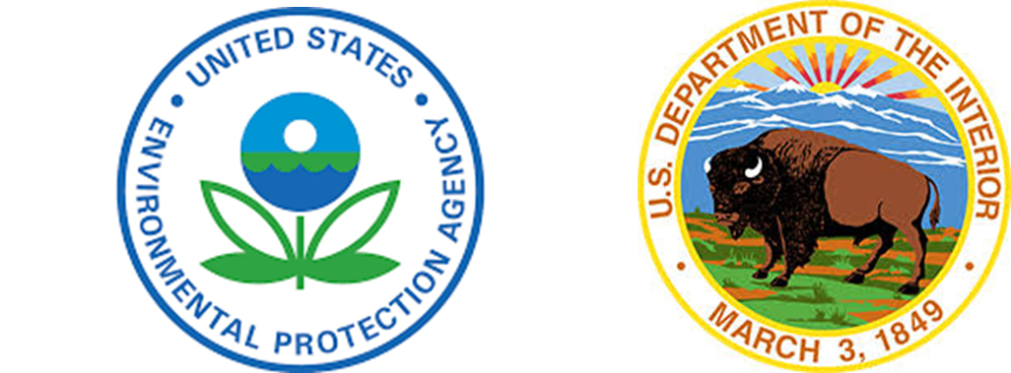
1994-2000
  Environmental laws appear to be around to stay
  Both the EPA and Department of Interior reach high levels of enforcement credibility

Slide 17
Changing Profile of Public Environmental Awareness and National Policy
  Increasing knowledge of science, etc.
  Shifting degree of industry influence on presidential policy, congressional affairs, and state governments
  Shifts in concepts of social responsibility and civil obligations of individuals and corporations
  Shift in ability of citizens to sue in court and intervene in agency proceedings.
  Accumulation of applicable legal doctrine, public law statues and regulations.
Notes:
Statute: a written law passed by a legislative body. Source: Dictionary.com
Regulations are mandatory requirements that can apply to individuals, businesses, state or local governments, non-profit institutions, or others. Source: www.epa.gov
Legal doctrine: A legal doctrine is a framework, set of rules, procedural steps, or test, often established through precedent in the common law, through which judgments can be determined in a given legal case. A doctrine comes about when a judge makes a ruling where a process is outlined and applied, and allows for it to be equally applied to like cases. When enough judges make use of the process, eventually it becomes established as the de facto method of deciding like situations. Source: https://en.wikipedia.org/wiki/Legal_doctrine

Slide 18
Regulatory Systems
All regulatory systems under environmental statutes have common elements
  Planning and priority setting
  Standard setting
  Permitting
  Monitoring and surveillance
  Enforcement

Slide 19
Cooperative Federalism = Federal/State Partnership
This entails
  Nationwide environmental planning
  Research and demonstration
  Standard setting at the federal level
  Delegation of legal authority to consenting states for
    Local environmental planning
    Set more stringent standards
    Administer permit systems
    Carry out monitoring, surveillance, and enforcement

Slide 20
Who sets the standards?
  Tenth amendment states “The powers not delegated to the United States by the Constitution, nor prohibited by it to the States, are reserved to the States respectively, or to the people.”
  Typically minimum standards are set by the Federal government; States may have standards that are stricter than Federal, they may not have standards that are more lax than Federal.

Slide 21

Several Significant Regulations
Clean Air Act
Clean Water Act
Endangered Species Act
Safe Drinking Water Act
Resource Conservation and Recovery Act/Hazardous and Solid Waste Amendments
Comprehensive Environmental Response, Compensation, and Liability Act/Superfund Amendments and Reauthorization Act
Notes:
Roseated Tern photo: https://ecos.fws.gov/ecp0/profile/speciesProfile?spcode=B07O

Slide 22
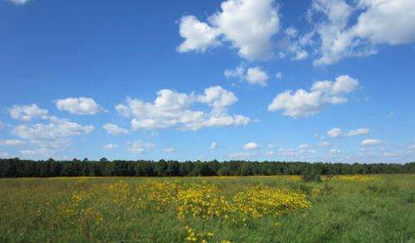
Clean Air Act (CAA)
Congress established much of the basic structure of the Clean Air Act in 1970, and made major revisions in 1977 and 1990.
To protect public health and welfare nationwide, the Clean Air Act requires EPA to establish national ambient air quality standards for certain common and widespread pollutants based on the latest science.
EPA has set air quality standards for six common “criteria pollutants":
  particulate matter (also known as particle pollution),
  ozone,
  sulfur dioxide,
  nitrogen dioxide,
  carbon monoxide,
  and lead.
Notes:
Dense, visible smog in many of the nation's cities and industrial centers helped to prompt passage of the 1970 legislation at the height of the national environmental movement. The subsequent revisions were designed to improve its effectiveness and to target newly recognized air pollution problems such as acid rain and damage to the stratospheric ozone layer.
https://www.epa.gov/clean-air-act-overview/clean-air-act-requirements-and-history, photo:
https://phys.org/news/2013-11-air-quality-chesapeake-bay-watershed.html

Slide 23
Clean Water Act (CWA)
The 1972 amendments:
  Established the basic structure for regulating pollutant discharges into the waters of the United States.
  Gave EPA the authority to implement pollution control programs such as setting wastewater standards for industry.
  Maintained existing requirements to set water quality standards for all contaminants in surface waters.
  Made it unlawful for any person to discharge any pollutant from a point source into navigable waters, unless a permit was obtained under its provisions.
  Funded the construction of sewage treatment plants under the construction grants program.
  Recognized the need for planning to address the critical problems posed by nonpoint source pollution.
Notes:
The Federal Water Pollution Control Act of 1948 was the first major U.S. law to address water pollution. Growing public awareness and concern for controlling water pollution led to sweeping amendments in 1972. As amended in 1972, the law became commonly known as the Clean Water Act (CWA).
https://www.epa.gov/laws-regulations/history-clean-water-act

Slide 24

Endangered Species Act (ESA)
The Endangered Species Act provides a program for the conservation of threatened and endangered plants and animals and the habitats in which they are found.
The law requires federal agencies, in consultation with the U.S. Fish and Wildlife Service and/or the NOAA Fisheries Service, to ensure that actions they authorize, fund, or carry out are not likely to jeopardize the continued existence of any listed species or result in the destruction or adverse modification of designated critical habitat of such species.
The law also prohibits any action that causes a "taking" of any listed species of endangered fish or wildlife.
Likewise, import, export, interstate, and foreign commerce of listed species are all generally prohibited.
Notes:
https://www.epa.gov/laws-regulations/summary-endangered-species-act, photo: us fish and wildlife.org

Slide 25
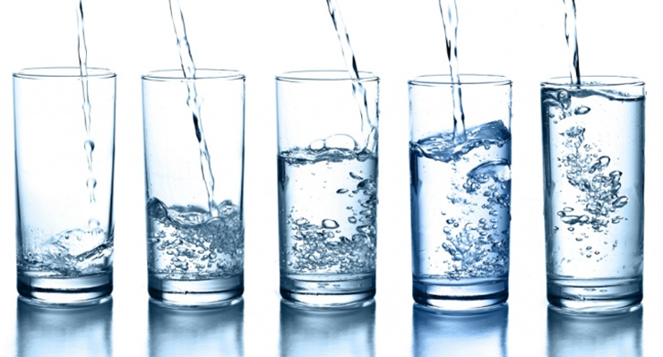
Safe Drinking Water Act (SDWA)
The Safe Drinking Water Act (SDWA) is the federal law that protects public drinking water supplies throughout the nation.
Under the SDWA, EPA sets standards for drinking water quality and with its partners implements various technical and financial programs to ensure drinking water safety.
Notes:
https://www.epa.gov/sdwa,
Image: http://www.verified-pixel.com/wp-content/uploads/2017/01/9Drinking-water.jpg

Slide 26
Resource Conservation and Recovery Act (RCRA)/Hazardous and Solid Waste Amendments (HSWA)
RCRA gives EPA the authority to control hazardous waste from the "cradle-to-grave." This includes the generation, transportation, treatment, storage, and disposal of hazardous waste.
HSWA are the 1984 amendments to RCRA that focused on waste minimization and phasing out land disposal of hazardous waste as well as corrective action for releases. Some of the other mandates of this law include
  increased enforcement authority for EPA,
  more stringent hazardous waste management standards, and
  comprehensive underground storage tank program.
Notes:
Hazardous waste is regulated under a “cradle to grave” concept, meaning that the waste is tracked via written records from the time it becomes a waste, and that ownership remains with the generator forever. Source: www.mtu.edu/ehs/forms-procedures/hazardous-waste/
Source: https://www.epa.gov/laws-regulations/summary-resource-conservation-and-recovery-act

Slide 27
Comprehensive Environmental Response, Compensation, and Liability Act (CERCLA)/Superfund Amendments and Reauthorization Act
-- otherwise known as Superfund -- provides a Federal "Superfund" to clean up uncontrolled or abandoned hazardous-waste sites as well as accidents, spills, and other emergency releases of pollutants and contaminants into the environment.
Through CERCLA, EPA was given power to seek out those parties responsible for any release and assure their cooperation in the cleanup.
EPA cleans up orphan sites when potentially responsible parties cannot be identified or located, or when they fail to act.
Through various enforcement tools, EPA obtains private party cleanup through orders, consent decrees, and other small party settlements.
EPA also recovers costs from financially viable individuals and companies once a response action has been completed.
Notes:
EPA is authorized to implement the Act in all 50 states and U.S. territories. Superfund site identification, monitoring, and response activities in states are coordinated through the state environmental protection or waste management agencies.
There are approximately 14 Superfund sites in Maine currently.
https://www.epa.gov/laws-regulations/summary-comprehensive-environmental-response-compensation-and-liability-act

Slide 28

What are some current concerns?
Pollution
Global Climate Change
Overpopulation
Natural Resource Depletion
Waste Disposal
Loss of Biodiversity
De-forestation
Ocean Acidification
Ozone Layer Depletion
Acid Rain
Water Pollution
Urban Sprawl
Public Health
Notes:
Ask students about other areas of the environment that they are concerned with.

Slide 29
www.maine.gov/dep

