Slide 1
Hazardous,
Universal & Electronic Wastes
Education Curriculum
High School Program
MAINE DEPARTMENT OF ENVIRONMENTAL PROTECTION
Protecting Maine’s Air, Land and Water
Notes:
Chapter 14 Principles of Environmental Engineering and Science
Chapter 18 Environmental Law & Policy

Slide 2
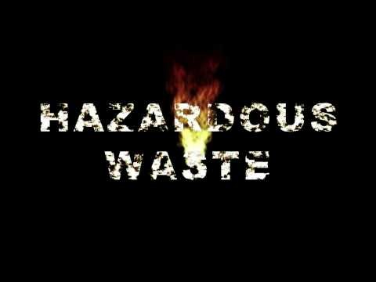
Hazardous Waste (run time 3:26)
Notes:
YouTube: https://www.youtube.com/watch?v=E_ui1maDVgs

Slide 3
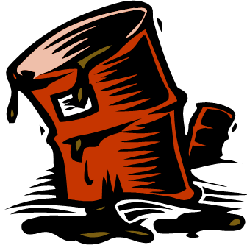
Hazardous Waste
Any waste or combination of wastes that poses a substantial danger, now or in the future, to human, plant, or animal life and that therefore must be handled and disposed of with special precautions.
Notes:
It is important to recognize that we, as a society, did not always know the materials we had generated would have the extreme adverse costs to affected environments and populations.

Slide 4
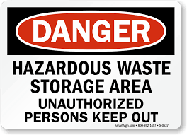
Generation &Travel of Wastes
Generator
Transporter
Treatment/Storage/Disposal
Notes:
It is always best to not generate hazardous waste in the first place, if you can find a less hazardous option.
Photo: https://images.mysafetysign.com/img/lg/S/hazardous-waste-danger-sign-s-0537.png

Slide 5
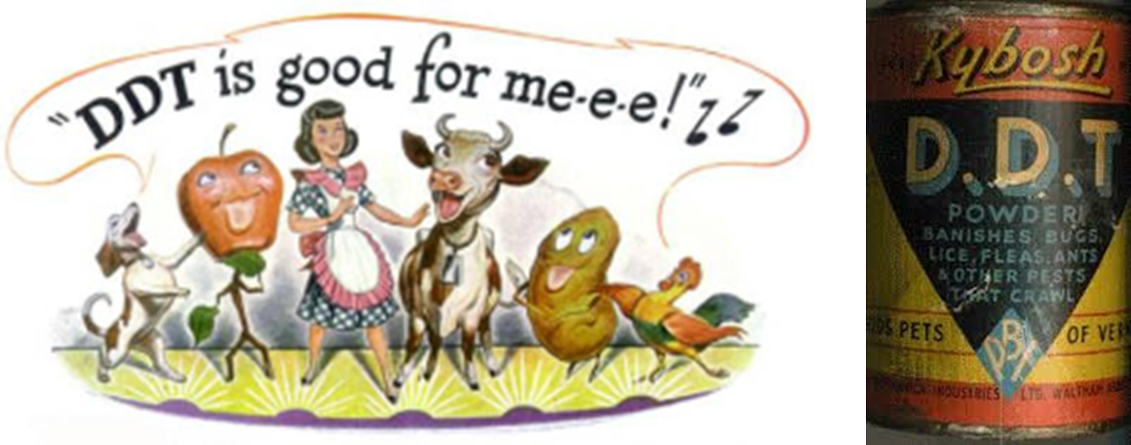
Landmark Episodes
DDT – insecticide exposure was associated with an increased frequency of cancer (1960s)
Notes:
DDT was a commonly-used pesticide for insect control in the United States until it was canceled in 1972 by the United States Environmental Protection Agency (EPA).DDT was initially used by the military in WW II to control malaria, typhus, body lice, and bubonic plague. npic.orst.edu/factsheets/ddtgen.pdf
DDT is: known to be very persistent in the environment,
will accumulate in fatty tissues, and
can travel long distances in the upper atmosphere.

Slide 6
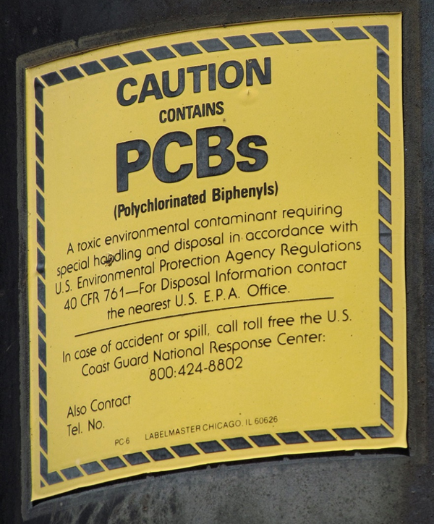
Landmark Episodes
Polychlorinated Biphenyl (PCB) – coolant, plasticizer, carbonless paper manufacturing – Suspected/Known cause of
  Birth defects
  Carcinogen
Notes:
PCBs are very stable mixtures that are resistant to extreme temperature and pressure. PCBs were used widely in electrical equipment like capacitors and transformers. www.idph.state.il.us/envhealth/factsheets/polychlorinatedbiphenyls.htm
Because of their longevity, PCBs are still widely in use, even though their manufacture has declined drastically since the 1960s, when a host of problems were identified.[ Because of PCBs' environmental toxicity and classification as a persistent organic pollutant, PCB production was banned by the United States Congress in 1979 and by the Stockholm Convention on Persistent Organic Pollutants in 2001. According to the EPA, PCBs cause cancer in animals and are probable human carcinogens. Many rivers and buildings including schools, parks, and other sites are contaminated with PCBs, and there have been contaminations of food supplies with the substances.
Source: https://en.wikipedia.org/wiki/Polychlorinated_biphenyl

Slide 7
Landmark Episodes
Love Canal was an canal project led by Mr. Love – the plan was to use water flow through the canal to capture the flow and to generate hydro power.
Fifteen-acre, working-class neighborhood of around 800 single-family homes built directly adjacent to the canal.
From 1942 to 1953, the Hooker Chemical Company, with government sanction, began using the partially dug canal as a chemical waste dump.
  21,000 tons of toxic chemicals, including at least twelve that are known carcinogens (halogenated organics, chlorobenzenes, and dioxin among them).
Notes:
Hooker capped the 16-acre hazardous waste landfill in clay and sold the land to the Niagara Falls School Board, attempting to absolve itself of any future liability by including a warning in the property deed.
Consecutive wet winters in the late 1970s raised the water table and caused the chemicals to leach (via underground swales and a sewer system that drained into nearby creeks) into the basements and yards of neighborhood residents, as well as into the playground of the elementary school built directly over the canal.
www.buffalonews.com
….The Herrs and two other families have filed a $113 million state lawsuit, alleging that the chemical landfill at Love Canal is leaking and that people in the nearby neighborhood have become ill from those chemicals.
More than 300 additional families – current or former residents of the repopulated Love Canal neighborhood – are talking about joining the lawsuit, according to the attorneys who filed the legal action.
“We have reason to believe that Love Canal-era chemicals have migrated onto our yards and into our homes. We have suffered property damage and serious ongoing health problems,” the three families wrote in an October 2011 letter to state and federal officials. “The matter is urgent.”…
President Jimmy Carter declared a state of emergency in 1978 and had the federal government relocate 239 families.
700 families remained even though tests conducted by the NYS Department of Health revealed that toxic substances were leaching into their homes.
Carter later declared a second state of emergency in 1981, during which the remaining families were relocated. Total Cost$17 million.

Slide 8
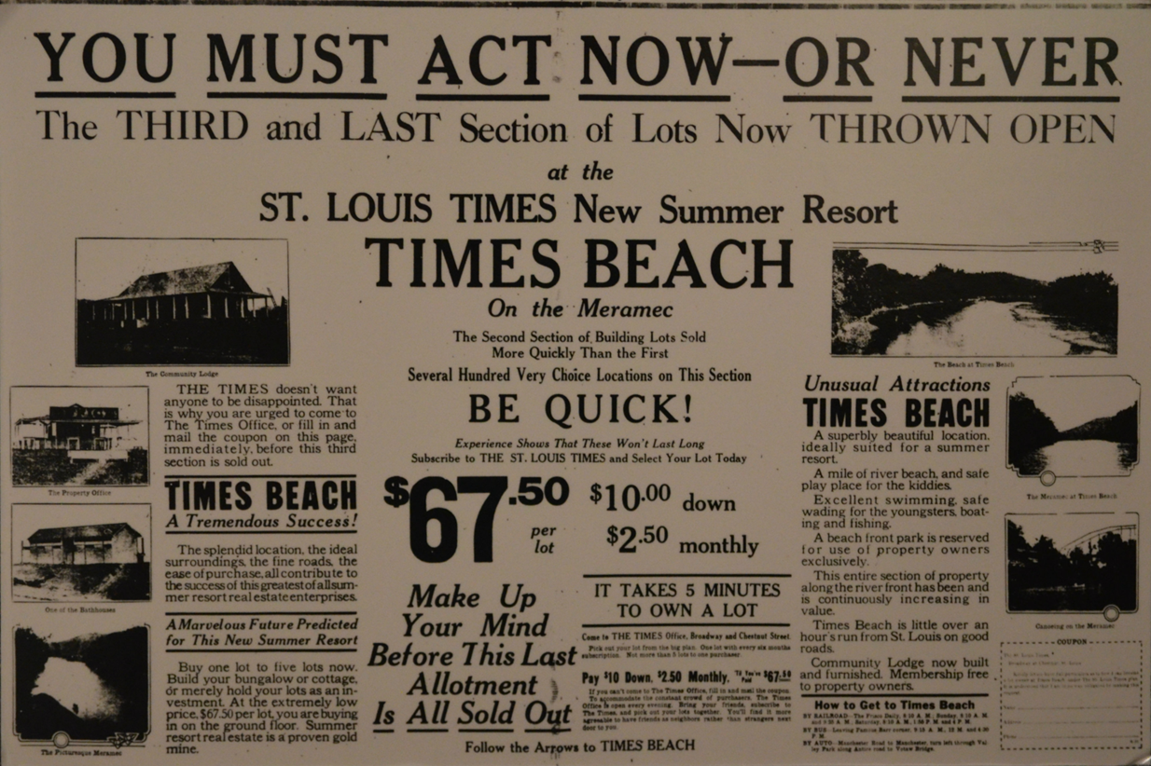
Landmark Episodes
Times Beach – Dioxin contamination
Notes:
Times Beach was founded in 1925. A purchase of a 20 × 100 ft (6 by 30 m) lot for $67.50 included a six-month newspaper subscription.
In its early years, the town was primarily a summer resort, but the Great Depression followed by gasoline rationing during World War II combined to reduce the feasibility of summer homes. The town became a community of mostly low-income housing, and a small population (1,240) lived in Times Beach by 1970. In the years immediately before its evacuation, Times Beach had become a lower-middle-class town.
Prone to flooding throughout its history—its first buildings were built on stilts - the town experienced a devastating flood in December, 1982. It happened just as the EPA was confirming that dioxin contaminated the soil, leading to the town's evacuation by 1985 and complete demolition by 1992. The town was dis-incorporated by executive order of Missouri governor John Ashcroft in 1985.
During the late 1960s, the Northeastern Pharmaceutical and Chemical Company, Inc. (NEPACCO) began operating out of a facility located near Verona, in southwestern Missouri. This facility was owned by Hoffman-Taff, a company that produced the Agent Orange herbicide for use during the Vietnam War.
From 1970 to 1972, NEPACCO was primarily involved in the production of hexachlorophene, an antibacterial agent used in soap, toothpaste, and common household disinfectants, from 2,4,5-trichlorophenol and formaldehyde.
Beginning the process of production with 2,4,5-trichlorophenol that contained 3-5 parts per million (ppm) of dioxin, NEPACCO was able to reduce the concentration of dioxin in hexachlorophene to 0.1 ppm. The result of this purification process led to the storage and accumulation of heavily concentrated dioxin still bottoms, or thick, oily residues, in a storage tank located near the facility in Verona. When NEPACCO first began operations, the still bottoms were sent to a waste facility in Louisiana for incineration. Although incineration was the best method to destroy dioxins at the time, it was also very expensive. Looking for less costly alternatives, NEPACCO contracted the services of the Independent Petrochemical Corporation (IPC). However, IPC, a chemical supplier company, knew very little about waste disposal, and subcontracted the NEPACCO job to Russell Martin Bliss, the owner of a small and local waste oil business. Charging NEPACCO $3000 per load, IPC paid Bliss $125 per load. Between February and October 1971, Bliss collected six truckloads (nearly 18,500 gallons) of chemical waste heavily contaminated with dioxin. Bliss took most of the still bottoms to his storage facility near Frontenac, Missouri, where the contaminated NEPACCO waste was unloaded and mixed into tanks containing used crankcase oils.
In addition to his waste oil business, Bliss owned a horse arena and farm, where he sprayed waste oils to control the problem of dust. One application kept the dust down for several months. Those who visited Bliss’ property were impressed by how well the technique worked. It was not long before people began to hire him for his dust-suppressant services.
On May 26, 1971, the owners of Shenandoah Stable, located near Moscow Mills, Missouri, Judy Piatt and Frank Hampel, paid Bliss $150 to spray the floor of their indoor arena. The waste oil sprayed, which totaled a volume of 2,000 gallons, was uncharacteristically thick, and left a pungent, burning odor. Within a few days of the spraying, birds began to drop dead from the rafters of the barns, and horses began to develop sores and lose their hair. Piatt and Hampel blamed these occurrences on Bliss, who denied responsibility, claiming that the material he sprayed was nothing more than old motor oil. Acting on their suspicions, Piatt and Hampel removed the top six inches of soil from the entire arena and disposed of it in a landfill. Despite the removal of another twelve inches of soil a few months later, the horses that came to the arena still became ill. After several months, sixty-two horses died, or became so emaciated that they had to be euthanized. Hampel, Piatt, and Piatt’s two young daughters also became ill, developing headaches, nosebleeds, abdominal pain, and diarrhea.
A month after the spraying at Shenandoah, Bliss was hired to spray the arena at Timberline Stables, near Jefferson City, Missouri. Twelve horses died, and children exposed to the arena were diagnosed with chloracne a skin condition associated with dioxin poisoning. Suspecting that Bliss’ oil was the source of their problems, the owners of Timberline removed the top layer of soil from their property.
A third arena, at Bubbling Springs Ranch, near St. Louis, was also sprayed around the same time as Timberline, and faced similar problems.
The unexplained deaths and illnesses at Shenandoah immediately caught the attention of the CDC. In August 1971, the CDC completed an inspection of Shenandoah Stable, and collected human and animal blood samples, as well as soil samples. It was not until 1973 that tests revealed the presence of trichlorophenol. On July 30, 1974, the CDC found that, in addition to 5,000 ppm of trichlorophenol and 1,590 ppm of PCBs, the soil samples collected from Shenandoah contained over 30 ppm of dioxin. Although little was known about the effects of dioxin on humans, the lethality of small doses in animals was alarming. As a result, the CDC immediately set out to locate other possible sites of contamination. When confronted by the CDC, Bliss stated that he did not know where the dioxin could have come from. Because dioxin was a by-product of only a handful of chemicals, trichlorophenol being the most common, the CDC narrowed their search to companies in Missouri using or producing trichlorophenol. NEPACCO was the only company on the search list that had come into contact with Bliss.

Slide 9
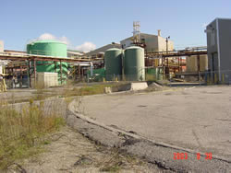
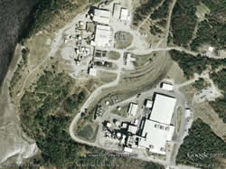
Maine Episode - Orrington, ME
Mallinckrodt
Notes:
Photos Maine DEP, Mallinckrodt (formerly HoltraChem) in Orrington Maine. Info – DEP.
The Mallinckrodt site, formerly known as the HoltraChem Manufacturing Company, in Orrington, Maine is located on a 235-acre site on the banks of the Penobscot River. Approximately 77 acres were affected by site operations including 50 acres that are developed and include the manufacturing facility, five landfills, a surface impoundment and a waste pile. The immediate plant area is approximately 12 acres. It opened in 1967 and manufactured chlorine, caustic soda (sodium hydroxide) and chlorine bleach (sodium hypochlorite) used by paper mills. The plant also manufactured hydrochloric acid and the pesticide chloropicrin. The plant closed in September, 2000. In early 2014 the site was split into two properties, one owned by Mallinckrodt US LLC and one owned by the Town of Orrington.
A site investigation determined that the Mallinckrodt site, including parts of the Penobscot River, is contaminated. The site contaminants include mercury, chloropicrin, volatile organic compounds, semi volatile organic compounds, and polychlorinated biphenols (PCBs).
Specifically, the following contaminants at a minimum are present on site:
Soils: chloropicrin, arsenic, barium, cadmium, chromium, lead, mercury, and PCBs.
Groundwater : 1,1 dichloroethane, acetone, bromodichloromethane, bromoform, carbon disulfide, carbon tetrachloride, chlorobenzene, chloroform, chloromethane, chloropicrin, dibromochloromethane, methylene chloride, tetrachloroethene, trichloroethene, manganese, mercury, potassium, and sodium.
Surface Water: carbon tetrachloride, chloroform, mercury, sodium, and pH.
Sediment: mercury
Biological samples: mercury

Slide 10
Classification of Hazardous Waste
Testing/Characteristics
  Corrosivity
  Ignitability
  Reactivity
  Toxicity
EPA Lists
  Most lists are “inclusive” lists
‘Self” listed by generator….
Notes:
Characteristic Waste
Corrosivity (pH ≤ 2 or ≥ 12.5)
Ignitability – easily ignited?
Reactivity – sudden reactions?
Toxicity - containing or being poisonous material especially when capable of causing death or serious debilitation
Listed wastes are wastes from common manufacturing and industrial processes, specific industries and can be generated from discarded commercial products. www.epa.gov
Self Listed are declared as hazardous by the companies that generate them.

Slide 11
Congressional Actions
1976
  Resource Conservation and Recovery Act (RCRA) 42 U.S.C. §§6001
1984
  Hazardous and Solid Waste Amendments (HSWA)
Both were meant to regulate the generation and disposal of hazardous waste.
1980
  Comprehensive Environmental, Response, Compensation, and Liability Act (CERCLA) 42 U.S.C. §§9601
1986
  Superfund Amendments and Reauthorization Act (SARA)
  Both were meant to address abandoned or closed waste disposal sites or spills
Notes:
The distinction is RCRA and HSWA cover generation and disposal of hazardous waste, CERCLA and SARA address abandoned or closed waste sites or spills.

Slide 12
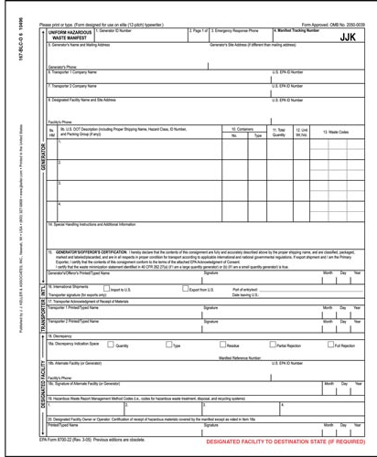
Cradle-to-Grave Concept
Developed to track hazardous waste from its generation point to its ultimate disposal point.
Manifest
  Generators must attach manifest to shipments.
  Designed to ensure that wastes are directed to, and actually reach, a permitted disposal site.
Notes:
Cradle – the point of generation. Those that generate the hazardous waste are ultimately responsible for it.
Grave – the point of treatment, storage, or disposal
The Manifest is the tracking sheet for the location and amount of waste.
A hazardous waste manifest sheet is shown.

Slide 13
Interstate Shipments
CERCLA threatens to withhold Superfund remedial actions in states that do not provide disposal capacity for the wastes generated within their borders.
  Capacity assurance plan (EPA approved) to show
    Adequate capacity for destruction, treatment or secure disposal of all wastes reasonably expected to be generated within the state
    20 year period
    Interstate shipment must be worked out in advance and be shown in a formal agreement

Slide 14
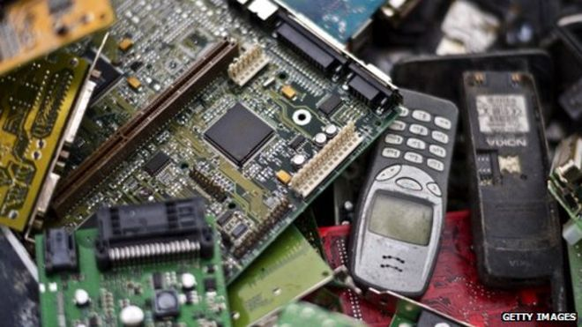
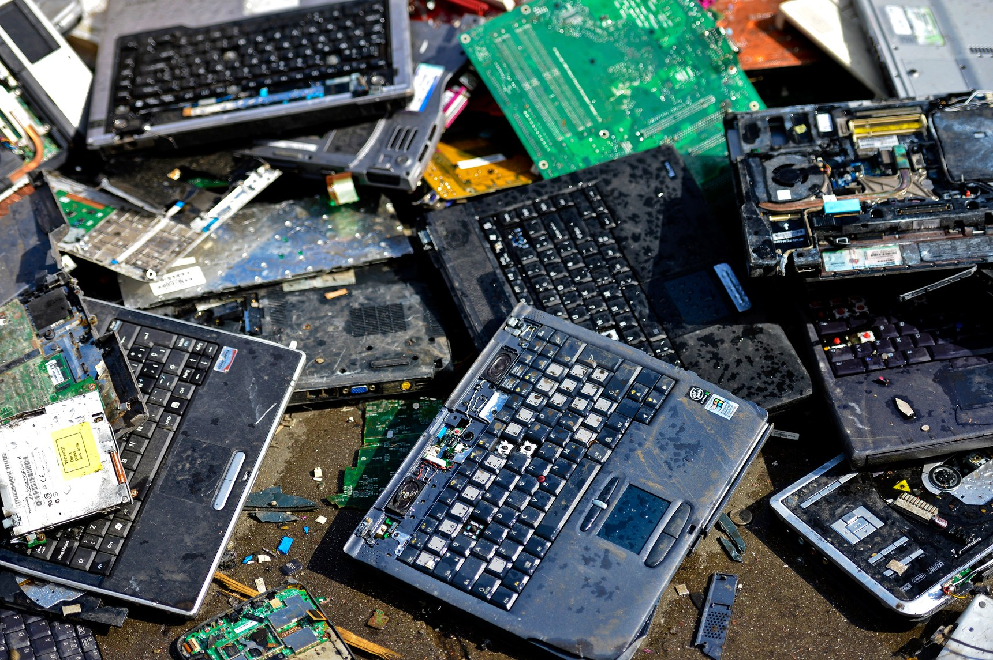
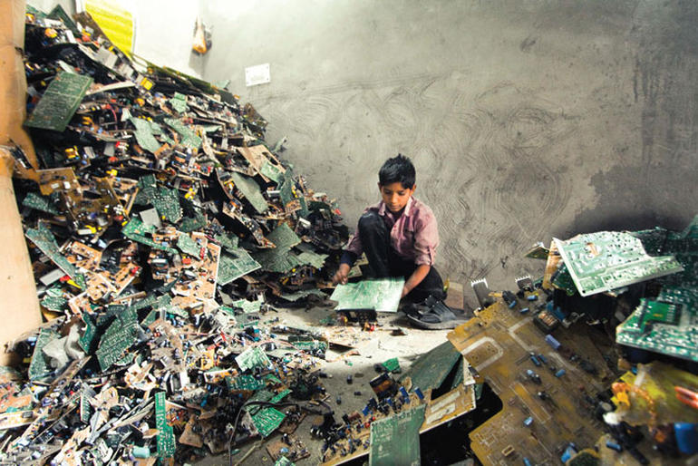
Electronic Wastes
In Maine electronic devices are described as Computer CPUs, desktop printers, video game consoles, cathode ray tubes, flat panel displays or similar video devices with a screen greater than 4 inches and contains one or more circuit boards.
Used electronics which are destined for reuse, resale, salvage, recycling, or disposal are also considered e-waste.
Maine requires that e-wastes be recovered or recycled, not disposed.
Notes:
Informal processing of e-waste in developing countries can lead to adverse human health effects and environmental pollution.
Source: https://en.wikipedia.org/wiki/Electronic_waste Photos: https://ichef.bbci.co.uk/news/660/media/images/82389000/jpg/_82389059_484913451.jpg, http://www.bcos.tv/images/2017/09/15/e-waste.jpg, https://zdnet3.cbsistatic.com/hub/i/r/2015/06/10/cbf406d6-ed30-408a-8022-daf9b9db38c7/resize/770xauto/226cf25257c4fc567185f959286e5744/e-waste-3.jpg

Slide 15
Electronic Wastes
Since the invention of the iPhone, cell phones have become the top source of e-waste products because they are not made to last more than two years.
Electrical waste contains hazardous but also valuable and scarce materials.
As of 2013, Apple has sold over 796 million iDevices (iPod, iPhone, iPad).
In the United States, an estimated 70% of heavy metals in landfills comes from discarded electronics.
Notes:
Up to 60 elements can be found in complex electronics. Cell phone companies make cell phones that are not made to last so that the consumer will purchase new phones. Companies give these products such short life spans because they know that the consumer will want a new product and will buy it if they make it.
Source: https://en.wikipedia.org/wiki/Electronic_waste

Slide 16
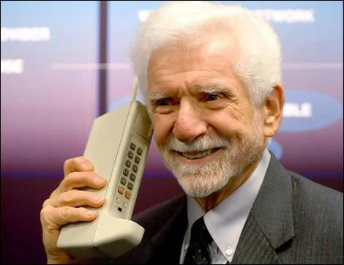
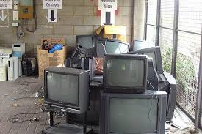
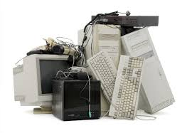
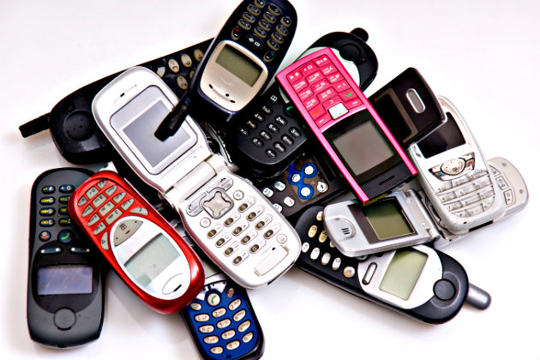

What Do You Do With
Your Old e-waste?
Notes:
Motorola was the first company to produce a handheld mobile phone. (Photo Upper Left) On April 3, 1973, Martin Cooper, a Motorola researcher and executive, made the first mobile telephone call from handheld subscriber equipment, placing a call to Dr. Joel S. Engel of Bell Labs, his rival. Source: https://en.wikipedia.org/wiki/History_of_mobile_phones
It would take a decade before Motorola's DynaTAC finally reached consumer hands. On September 21, 1983, Motorola made history when the FCC approved the 8000X, the world's first commercial portable cell phone. It cost consumers a whopping$3,995 at the time.
Source:
www.foxnews.com/tech/.../first-mobile-phone-call-was-placed-40-years-ago-today.html
Photos: https://vignette1.wikia.nocookie.net/uncyclopedia/images/9/91/2_old_school_cell_phone.jpg/revision/latest?cb=20120325144236, http://www.premiumposts.com/oldschool-cell-phone-for-sale, http://mix949.com/files/2014/05/5-27-14-old-cell-phones-go.jpg, www.missclub.info, unlockiphone4s.com

Slide 17
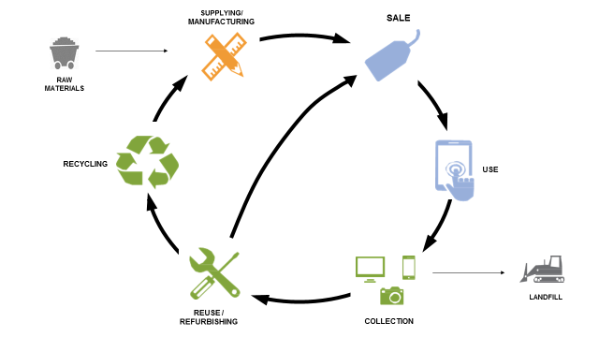
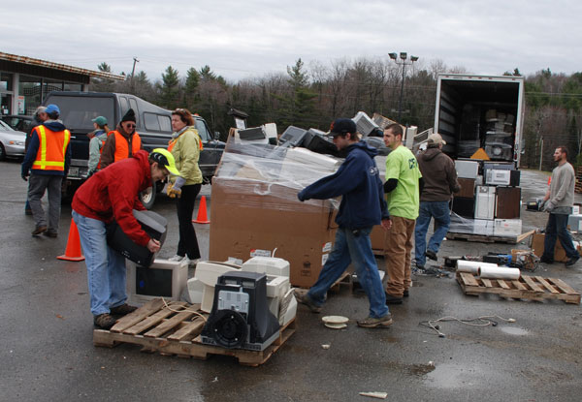
Life Cycle Stages of Electronics
e-waste drop off facility
Notes:
Around 2014 the Americas produced 11.7 million metric tons of electronic waste.
Source: https://www.statista.com/statistics/499921/ewaste-generation-worldwide-by-region/
Figure: Source: https://www.epa.gov/smm-electronics/basic-information-about-electronics-stewardship#01
E waste drop off facility photo: daily bulldog

Slide 18

www.maine.gov/dep

