Slide 1
Health Effects of Air Pollution
Education Curriculum
High School Program
MAINE DEPARTMENT OF ENVIRONMENTAL PROTECTION
Protecting Maine’s Air, Land and Water
Notes:
https://www.epa.gov/outdoor-air-quality-data
http://www.maine.gov/dep/air/ozone/

Slide 2

Why Should We Care About Air Pollution?
Notes:
Ask students why they feel it is important to have clean air. Air Pollution can cause damage to health, the environment and property.

Slide 3
Air Pollution
The Clean Air Act requires EPA to set National Ambient Air Quality Standards (NAAQS) for six common air pollutants (also known as “criteria air pollutants").
These pollutants are found all over the U.S., some from natural sources and some from man-made sources.
They can harm your health and the environment, and cause property damage.
Notes:
https://www.epa.gov/criteria-air-pollutants

Slide 4

Criteria Air Pollutants
carbon monoxide
lead
ground-level ozone
particulate matter
nitrogen dioxide
sulfur dioxide
Notes:
Non-criteria pollutants include benzene, dioxins and pesticides.
This photo shows smog in the Los Angeles area.
http://www.scphysiciangroup.com/wp-content/uploads/2015/11/los-angeles-smog-1.jpg

Slide 5
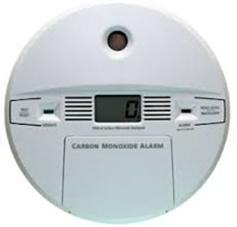
Carbon Monoxide
Incomplete oxidation of carbon results in the production of carbon monoxide.
  Natural CO formation occurs from photochemical reactions in the troposphere, volcanoes, forest fires, etc.
Breathing air with a high concentration of CO reduces the amount of oxygen that can be transported in the blood stream to critical organs like the heart and brain.
At very high levels, which are possible indoors or in other enclosed environments, CO can cause dizziness, confusion, unconsciousness and death.
Notes:
Very high levels of CO are not likely to occur outdoors. However, when CO levels are elevated outdoors, they can be of particular concern for people with some types of heart disease. These people already have a reduced ability for getting oxygenated blood to their hearts in situations where the heart needs more oxygen than usual. They are especially vulnerable to the effects of CO when exercising or under increased stress. In these situations, short-term exposure to elevated CO may result in reduced oxygen to the heart accompanied by chest pain also known as angina. https://www.epa.gov/co-pollution/basic-information-about-carbon-monoxide-co-outdoor-air-pollution#What is CO
Anthropogenic sources are “man made” sources, typically by incomplete combustion. CO can become high indoors by incomplete combustion in an improperly operating furnace.

Slide 6
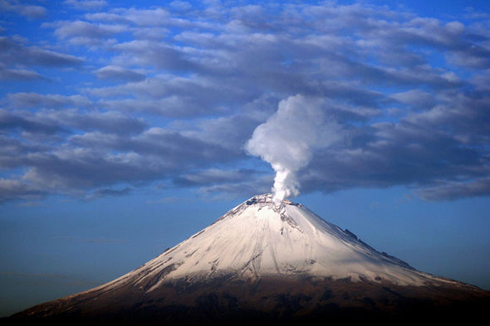
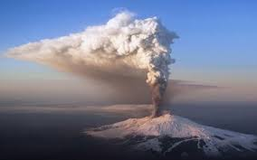
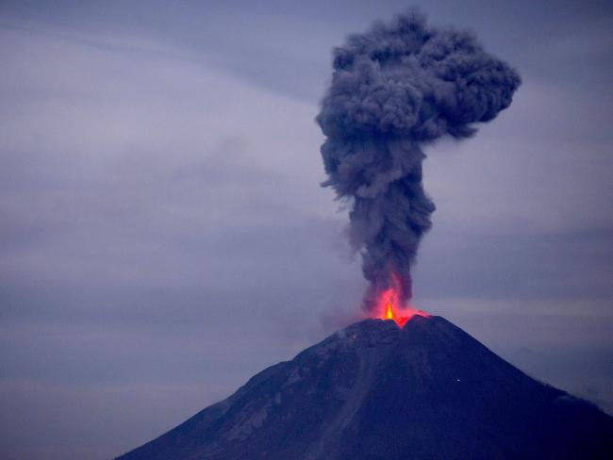
Lead
Sources of lead emissions vary from one area to another.
  At the national level, major sources of lead in the air are ore and metals processing and piston-engine aircraft operating on leaded aviation fuel.
  Other sources are waste incinerators, utilities, and lead-acid battery manufacturers. The highest air concentrations of lead are usually found near lead smelters.
  Volcanic activity and airborne soil are the primary natural sources of atmospheric lead.
Notes:
Some feel leaded gas provides more power and less engine knocking for airplane engine operation. Piston aviation engines have historically used leaded gas to provide these desired qualities.
Plants that produce of lead are known as lead smelters.
https://www.epa.gov/lead-air-pollution/basic-information-about-lead-air-pollution#how
Left - https://cdn.images.express.co.uk/img/dynamic/151/590x/secondary/popo-1087976.jpg
Mid picture - http://www.telegraph.co.uk/content/dam/Travel/2017/January/volcano-etna-F7XAC3.jpg?imwidth=450
Right - http://cdn.newsapi.com.au/image/v1/cf1189b89fa9c40c5a2c9f4a8bdcbd60

Slide 7
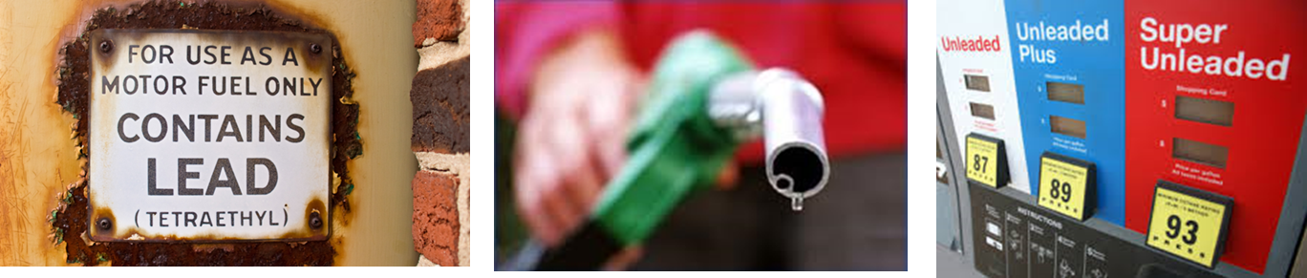
Lead
As a result of EPA's regulatory efforts including the removal of lead from motor vehicle gasoline, levels of lead in the air decreased by 98 percent between 1980 and 2014.
Notes:
Some countries (as of 2014) still use leaded fuel, or a combination of leaded and unleaded fuel may be available: Afghanistan, Algeria, Iraq, Burma, Yemen and North Korea. It is not always clear how much leaded gas may be used by these countries.

Slide 8
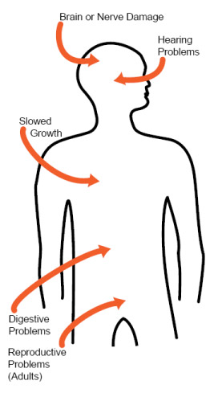
Lead
Once taken into the body, lead distributes throughout the body in the blood and is accumulated in the bones.
Depending on the level of exposure, lead can adversely affect the nervous system, kidney function, immune system, reproductive and developmental systems and the cardiovascular system.
Lead exposure also affects the oxygen carrying capacity of the blood.
Notes:
The lead effects most commonly encountered in current populations are neurological effects in children and cardiovascular effects (e.g., high blood pressure and heart disease) in adults. Infants and young children are especially sensitive to even low levels of lead, which may contribute to behavioral problems, learning deficits and lowered IQ.
Lead Is a cumulative poison. It is ingested in food and water (5-10% absorbed) as well as being inhaled (20-50%).
https://www.epa.gov/lead-air-pollution/basic-information-about-lead-air-pollution#how
Photo: http://www.leadsafeillinois.org/uploads/images/body-diagram.jpg

Slide 9
Ground Level Ozone
Ozone is formed in the atmosphere when energetic ultraviolet (UV) radiation dissociates molecules of oxygen, O₂, into separate oxygen atoms.
Free oxygen atoms can recombine to form oxygen molecules but if a free oxygen atom
(O⁻²) collides with an oxygen molecule(O₂), it joins up, forming ozone (O₃).
Notes:
High level atmospheric ozone is desired - it absorbs ultraviolet radiation from the sun - but ground level ozone is not.

Slide 10

Ozone
Breathing ozone can trigger a variety of health problems, particularly for children, the elderly, and people of all ages who have lung diseases such as asthma.
Ground level ozone can also have harmful effects on sensitive vegetation and ecosystems.
Notes:
Photo https://www.google.com/search?rlz=1C1GGRV_enUS751US751&biw=1242&bih=602&tbm=isch&sa=1&ei=iDsTWv7tAuXajwSjoLugBQ&q=screen+beans&oq=screen+beans&gs_l=psy-ab.3..0l3j0i67k1j0l3j0i67k1j0l2.64982.67250.0.67365.14.14.0.0.0.0.155.1586.0j13.14.0....0...1c.1.64.psy-ab..0.13.1583.0..0i10k1.92.Mcs8etxpB5Q#imgrc=aU3Yt06G1M4qsM:

Slide 11
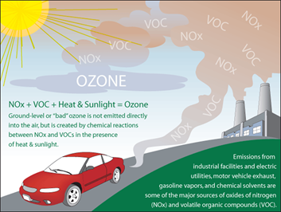
Ozone
Notes:
Volatile Organic Compounds are a large group of carbon-based chemicals that easily evaporate at room temperature.
While most people can smell high levels of some VOCs, others have no odor - Odor does not indicate the level of risk from inhalation of this group of chemicals.
VOCs are often in household products including: paints, paint strippers, and other solvents; wood preservatives; aerosol sprays; cleansers and disinfectants; moth repellents and air fresheners; stored fuels and automotive products; hobby supplies; dry-cleaned clothing
NOX is nitrous oxide, which will be covered later in more detail.
Photo: http://www.theozonehole.com/images/ozoneform.gif

Slide 12
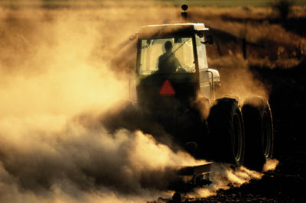
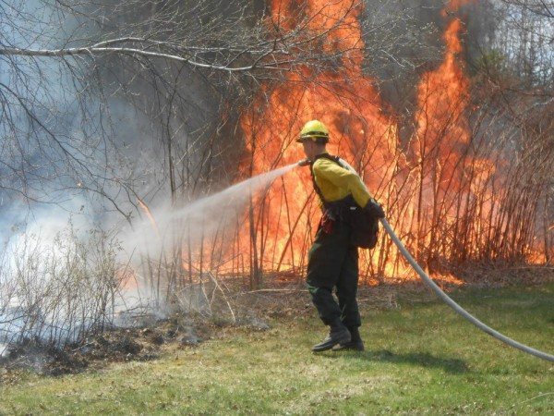
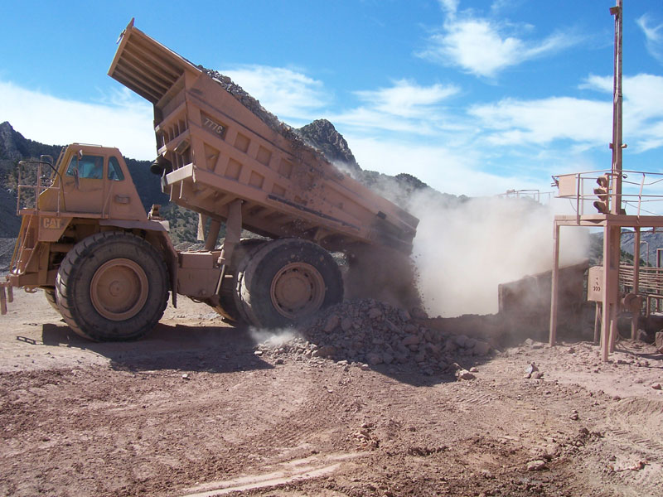
Particulate Matter
Sea salt, soil dust, volcanic particles, smoke from forest fires account for particulate emissions each year.
Small particles are removed from the atmosphere by accretion to water droplets, which grow in size until they are large enough to precipitate.
Larger particles are removed by direct washout by falling raindrops.
Notes:
Soil dust can be kicked up during farming or construction (photos left and right) and particulate matter such as ash from forest fires (center photo) can also pollute the air.
Soil dust photo: https://images.nature.com/full/nature-assets/nature/journal/v447/n7146/images/447777a-i1.0.jpg
Fire fighter photo: https://bdn-data.s3.amazonaws.com/uploads/2014/01/10016401_H10797701-600x450.jpg
Dump truck photo: http://dustcontroltech.com/wp-content/uploads/Typical-Dump-Area-in-need-of-Dust-Suppresion.jpg

Slide 13
Particular Matter
EPA groups particle pollution into two categories:
"Inhalable coarse particles," such as those found near roadways and dusty industries, are larger than 2.5 micrometers and smaller than 10 micrometers in diameter.
"Fine particles," such as those found in smoke and haze, are 2.5 micrometers in diameter and smaller. These particles can be directly emitted from sources such as forest fires, or they can form when gases emitted from power plants, industries and automobiles react in the air.
Notes:
Source: https://www3.epa.gov/region1/eco/uep/particulatematter.html

Slide 14
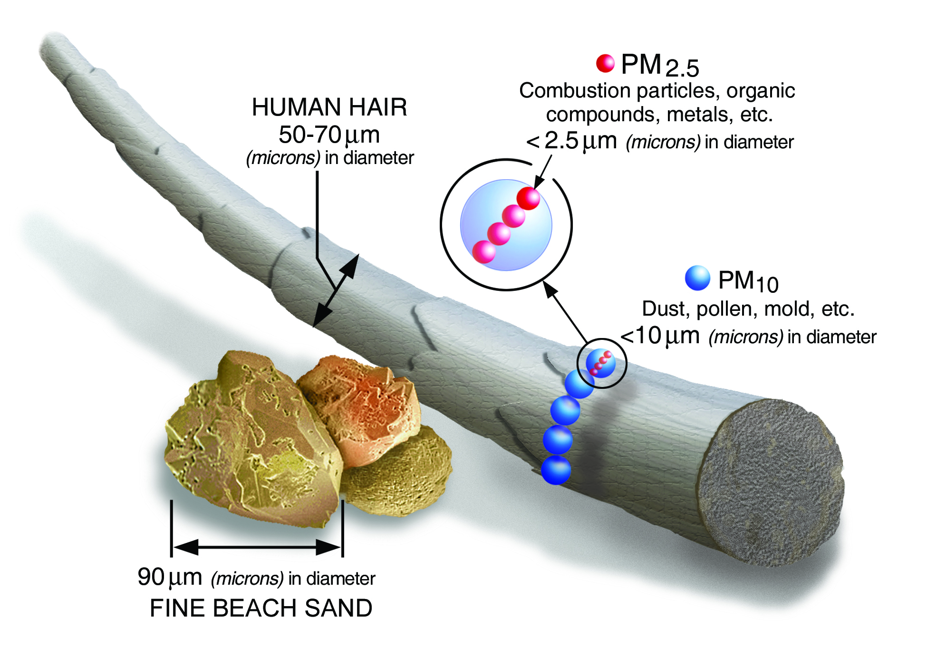
Particulate Matter
Notes:
Ask students to look at a strand of their hair and to consider how small it is in diameter. Remind them that this is the diameter size of the particles that can cause respiratory issues in humans.
Photo: https://www.epa.gov/sites/production/files/2016-09/pm2.5_scale_graphic-color_2.jpg

Slide 15
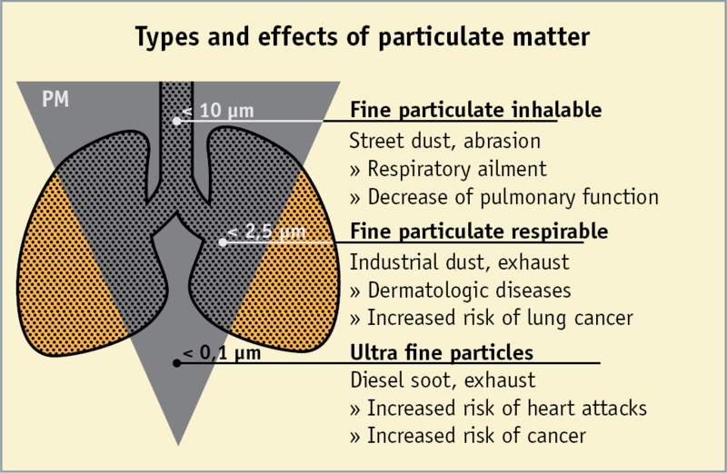
Particulate Matter
Particulate matter contains microscopic solids or liquid droplets that are so small that they can be inhaled and cause serious health problems.
Notes:
Particles less than 10 micrometers (μm) in diameter pose the greatest problems, because they can get deep into your lungs, and some may even get into your bloodstream.
Fine particles (PM_{2.5}) are the main cause of reduced visibility (haze) in parts of the United States, including many of our treasured national parks and wilderness areas.
Source: https://www.epa.gov/pm-pollution/particulate-matter-pm-basics#effects, Photo: http://www.clean-heat.eu/fileadmin/_processed_/4/1/csm_6-particulate_matter_lung_4dff51a183.png

Slide 16
Nitrous Oxides
Nitrogen Dioxide (NO₂) is one of a group of highly reactive gases known as oxides of nitrogen or nitrogen oxides (NO_{x}).
Although some is naturally occurring, NO₂ primarily gets in the air from the burning of fuel.
NO₂ forms from emissions from cars, trucks and buses, power plants, and off-road equipment.
Notes:
Other nitrogen oxides include nitrous acid and nitric acid. NO₂ is used as the indicator for the larger group of nitrogen oxides.
https://www.epa.gov/no2-pollution/basic-information-about-no2#What is NO2

Slide 17
Nitrous Oxides
Breathing air with a high concentration of NO₂ can irritate airways in the human respiratory system.
  Such exposures over short periods can aggravate respiratory diseases, particularly asthma, leading to respiratory symptoms (such as coughing, wheezing or difficulty breathing), hospital admissions and visits to emergency rooms.
  Longer exposures to elevated concentrations of NO₂ may contribute to the development of asthma and potentially increase susceptibility to respiratory infections. People with asthma, as well as children and the elderly are generally at greater risk for the health effects of NO₂.
  NO₂ along with other NO_{x} reacts with other chemicals in the air to form both particulate matter and ozone. Both of these are also harmful when inhaled due to effects on the respiratory system.
Notes:
Asthma attacks and respiratory issues can cause lost school days for students and lost work days for parents, not to mention the discomfort and scare caused by the inability to breath comfortably.
https://www.epa.gov/no2-pollution/basic-information-about-no2#What is NO2

Slide 18
Sulfur Oxides
The largest source of SO₂ in the atmosphere is the burning of fossil fuels by power plants and other industrial facilities.
Smaller sources of SO₂ emissions include:
  industrial processes such as extracting metal from ore
  natural sources such as volcanoes
  and locomotives, ships and other vehicles and heavy equipment that burn fuel with a high sulfur content.
Notes:
International conventions now require that most ships burn low sulfur fuels, or that the ship has a “scrubber” to remove sulfur from the exhaust stream from the ship.
https://www.epa.gov/so2-pollution/sulfur-dioxide-basics#what is so2

Slide 19

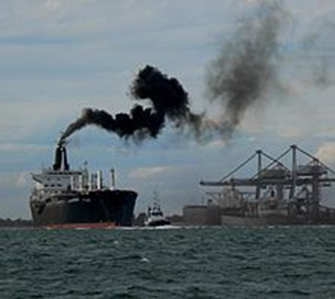
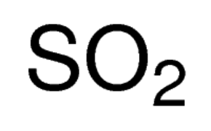
Sulfur Oxides
At high concentrations, gaseous SO₂ can harm trees and plants by damaging foliage and decreasing growth and can contribute to acid rain which can harm sensitive ecosystems.
Short-term exposures to SO₂ can harm the human respiratory system and make breathing difficult. Children, the elderly, and those who suffer from asthma are particularly sensitive to effects of SO₂.
Notes:
Unpolluted rain is naturally acidic because CO₂ from the atmosphere dissolves to a sufficient extent to form carbonic acid.
rainwater ph = 5.0-5.6. carbon dioxide and water in the air react together to form carbonic acid, a weak acid. Thus, normal rainwater has a pH of 5.6.
When the pH level of rainwater goes below 5.6, it is considered acid rain.
https://www.epa.gov/so2-pollution/sulfur-dioxide-basics#what is so2
Leaf photo: https://63af7a55-a-402a74db-s-sites.googlegroups.com/a/owu.edu/effects-of-acid-precipitation-on-fish-and-fish-eggs/what-organisms-are-affected-by-acid-precipitation/leaf.jpg?attachauth=ANoY7cqmWl2oYbNPDvKZlaELeuxo3R-bmjzT2_ywWeiyzYEX7ZoG2x3UgkciqQLhF5KDm5Pbwh0_GuIhSSxgzA76b55d7_YGJovJBHkTB41iDPcaM7Ao5ulGXB9mjhZQeCe9Py6OzDko2CROtyrd6N623685LJYyaUr9upoLO7Zidmou6iq3TEzXdKHEVJfxUHoEYqsGiCkj7EK1jmvtUvVGM8br5gTCFjwPBe_ucXWiYEwsFcZU0y8SU01P-_hQzbrSqJb59qyaEQOBaejvQlnhlFZ1APKduygNQomp7JnDZTXDZXFfBNZiTupP6V4WL1Nt6fvoDHCG&attredirects=0
Ship photo: https://en.wikipedia.org/wiki/Sulphur_Emission_Control_Area

Slide 20
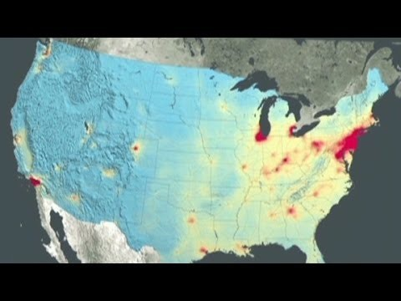
NASA: U.S. air quality improving (1:55)
Notes:
YouTube Video: https://www.youtube.com/watch?v=L_6F0N2Ep3A

Slide 21

What is the Air Quality Today in Your Town?
Notes:
See your Lesson Plan for the Air Quality Project.
http://www.maine.gov/dep/air/ozone/

Slide 22

www.maine.gov/dep

