Slide 1
Ocean Acidification
Education Curriculum
Middle School Program
MAINE DEPARTMENT OF ENVIRONMENTAL PROTECTION
Protecting Maine’s Air, Land and Water
Notes:
Source of Information: http://www.whoi.edu/OCB-OA/page.do?pid=112076

Slide 2
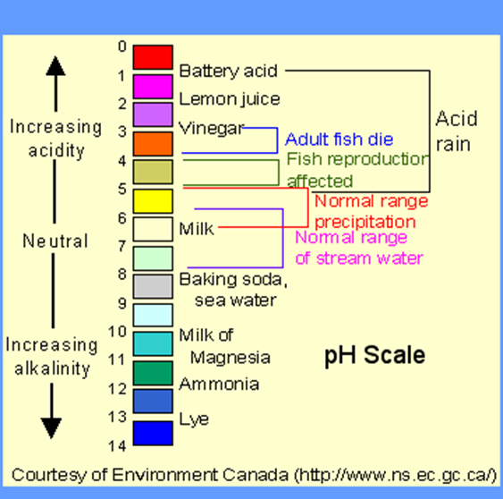

Reminder: pH scale
The pH scale measures how acidic or basic a substance is.
The pH scale ranges from 0 to 14.
  A pH of 7 is neutral.
  A pH less than 7 is acidic.
  A pH greater than 7 is basic.
MAINE DEPARTMENT OF ENVIRONMENTAL PROTECTION www.maine.gov/dep
Notes:
Source of info and photo: http://chemistry.elmhurst.edu/vchembook/184ph.html

Slide 3
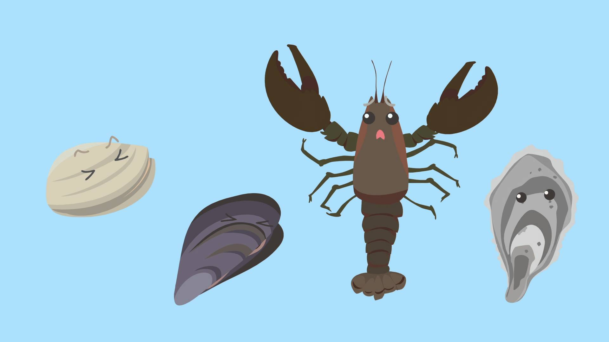
(Run Time ~ 4:26)
A Climate Calamity in The Gulf of Maine Part 2: Acid in the Gulf
MAINE DEPARTMENT OF ENVIRONMENTAL PROTECTION www.maine.gov/dep
Notes:
Video: https://www.youtube.com/watch?v=ZimEBFw1Q7c

Slide 4
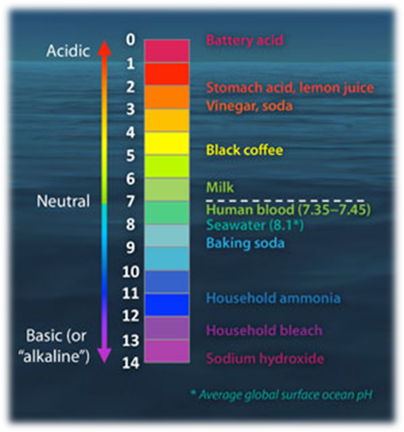
What is the difference between pH and acidity?
pH is the scale on which acidity is measured, and so it describes how much acid is in a liquid.
The amount of hydrogen ions in a liquid determines how acidic the liquid is.
Notes:
Hydrogen ions can be present in a range from 1 down to extremely small numbers (0.00000000000001). To avoid error from writing down all the zeros, scientists use a logarithmic scale and call this scale pH.
Because the pH scale is logarithmic (pH = -log[H⁺]), a change of one pH unit corresponds to a ten-fold change in hydrogen ion concentration
Many natural processes affect acidity levels in the environment—examples include photosynthesis and respiration—so the acidity may vary by an order of magnitude or more (or in pH units, by 1 or more) as a result of natural biological, physical, and geological processes on a variety of different spatial and temporal scales.

Slide 5
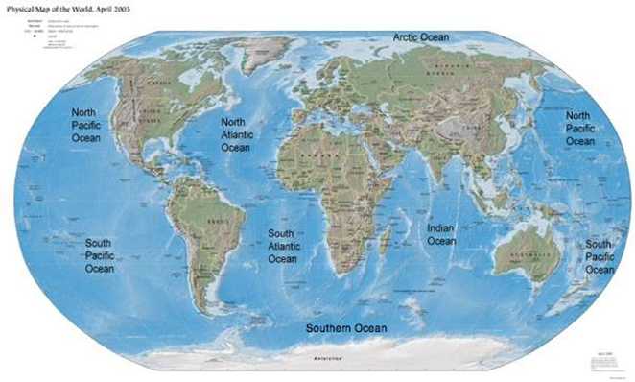
What is Ocean Acidification?
International experts define ocean acidification (OA) as a decrease in ocean pH over decades or more that is caused primarily by uptake of CO₂ from the atmosphere.
Because human activities are releasing CO₂ into the atmosphere very quickly, the ocean is taking up CO₂ faster today than it has in the past.
This is causing global ocean chemistry to change more quickly than ocean systems can handle.
Notes:
Photo Source: http://www.earthonlinemedia.com/ebooks/tpe_3e/earth_system/the_oceans.html
While ocean acidification refers to the global change in ocean chemistry from atmospheric inputs of carbon dioxide, coastal acidification is another mechanism by which coastal chemistry can change.
Coastal acidification includes local changes in water chemistry from freshwater river inputs and excess nutrient run-off (e.g. nitrogen and organic carbon) from land. Excess nutrients from runoff and fertilizers can cause increases in algal growth. When these algal blooms die, they consume oxygen and release carbon dioxide. Pollution and fertilizers are another mechanism by which carbon dioxide can increase in our coastal waters, threatening our waterways close to home. Source: http://oceanacidification.noaa.gov/OurChangingOcean.aspx

Slide 6
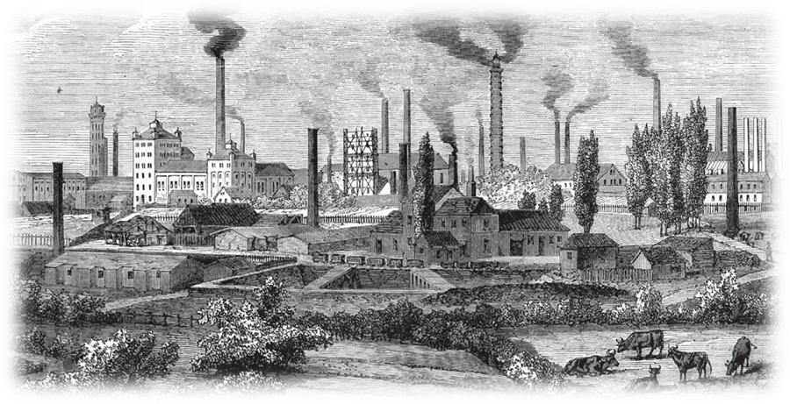
Ocean Acidification Trends
Ocean acidification, related to the uptake of CO2 at the ocean surface, causes a relatively slow, long-term increase in the acidity of the ocean, corresponding to a decrease in pH.
Since the Industrial Revolution, the global average pH of the surface ocean has decreased by 0.11, which corresponds to approximately a 30% increase in the hydrogen ion concentration.
Notes:
The Industrial Revolution was the transition to new manufacturing processes in the period from about 1760 to sometime between 1820 and 1840. This transition included going from hand production methods to machines, new chemical manufacturing and iron production processes, the increasing use of steam power, the development of machine tools and the rise of the factory system.
https://en.wikipedia.org/wiki/Industrial_Revolution
Photo http://download-wallpaper.net/content/industrial-revolution-1.html

Slide 7
Why be concerned with a small change in pH?
Many organisms are very sensitive to seemingly small changes in pH.
Many marine organisms are very sensitive to either direct or indirect effects of the change in acidity (or H⁺ concentration) in the marine environment.
Fundamental physiological processes such as respiration, calcification (shell/skeleton building), photosynthesis, and reproduction respond to the magnitude of changes in CO₂ concentrations in seawater.
Notes:
Many scientists have observed that natural variability in seawater acidity (and thus pH) over days, weeks, and months is strong. This short-term variability can be much larger than the recent and forecasted changes in acidity that will take place over decades to centuries because of ocean acidification.
The reason that scientists are concerned about this slow, long-term change is that it changes the environmental baseline. This means that the natural variability in acidity due to photosynthesis, respiration, upwelling, and many other processes will be overlaid on an ever-increasing average concentration of H⁺. Even though this change in the baseline is slow and steady relative to human time scales, this change is very fast relative to geological time scales.
Ocean acidification is more rapid than any change in ocean acidity documented over the last 300 million years, so organisms that tolerate a certain narrow range of conditions may encounter increasingly stressful, or even lethal, conditions in the coming decades

Slide 8
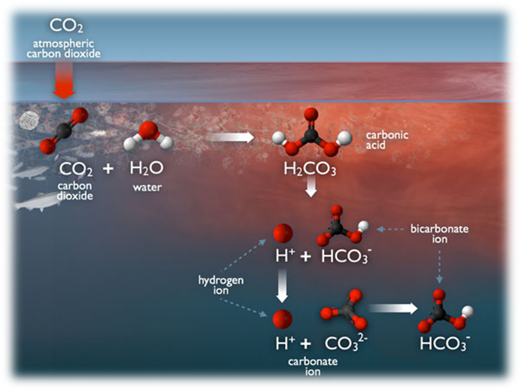
Ocean Acidification Chemistry
As carbon dioxide (CO₂) dissolves into seawater it creates carbonic acid.
Through a series of chemical reactions, carbonic acid releases hydrogen ions (H⁺), which decreases seawater pH, and decreases the concentration of carbonate ions (CO₃²⁻), which provide chemical building blocks for marine organisms’ shells and skeletons.

Slide 9
Ocean Absorption of CO2
The ocean absorbs about a quarter of the CO₂ we release into the atmosphere every year, so as atmospheric CO₂ levels increase, so do the levels in the ocean.
Initially, many scientists focused on the benefits of the ocean removing this greenhouse gas from the atmosphere. However, decades of ocean observations now show that there is also a downside — the CO₂ absorbed by the ocean is changing the chemistry of the seawater.

Slide 10
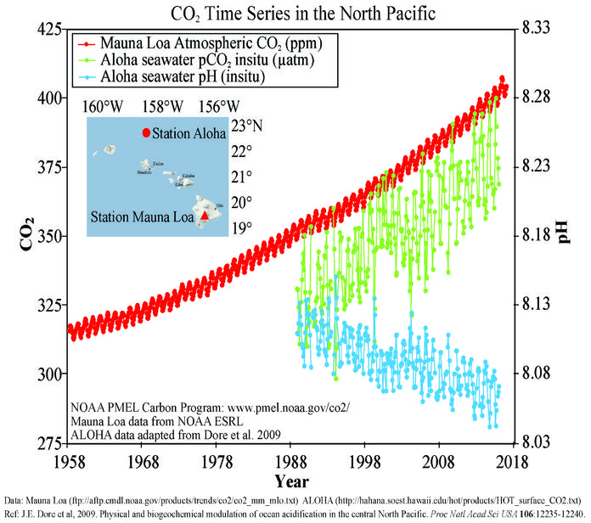
Notes:
As CO2 levels rise in the ocean (red curve) the pH levels drop (blue curve)

Slide 11
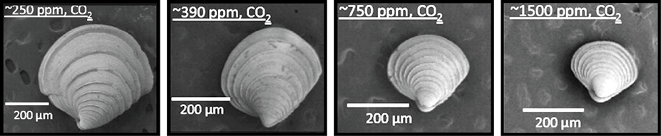
Some Issues with lower pH
Calcium carbonate minerals are the building blocks for the skeletons and shells of many marine organisms.
In areas where most life now congregates in the ocean, the seawater is supersaturated with respect to calcium carbonate minerals. This means there are abundant building blocks for calcifying organisms to build their skeletons and shells.
However, continued ocean acidification is causing many parts of the ocean to become under-saturated with these minerals, which is likely to affect the ability of some organisms to produce and maintain their shells.
Notes:
Note that as the ppm of CO2 goes up, the size of the shell decreases (reduced growth).
https://www.pmel.noaa.gov/co2/story/What+is+Ocean+Acidification%3F
Photo: globalchange.org
Clams stunted growth due to higher CO2 levels in the oceans.

Slide 12
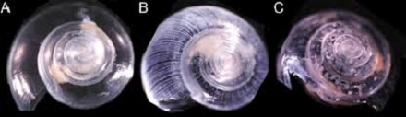
Some Issues with lower pH
Carbonate ions are an important building block of structures such as sea shells and coral skeletons.
  Decreases in carbonate ions can make building and maintaining shells and other calcium carbonate structures difficult for calcifying organisms such as oysters, clams, sea urchins, shallow water corals, deep sea corals, and calcareous plankton.
These changes in ocean chemistry can affect the behavior of non-calcifying organisms as well.
  Certain fish's ability to detect predators is decreased in more acidic waters. When these organisms are at risk, the entire food web may also be at risk.
Notes:
Source: https://oceanservice.noaa.gov/facts/acidification.html
Photo: Shells dissolving in lab-simulated ocean acidification conditions. Photo credit: NOAA.

Slide 13
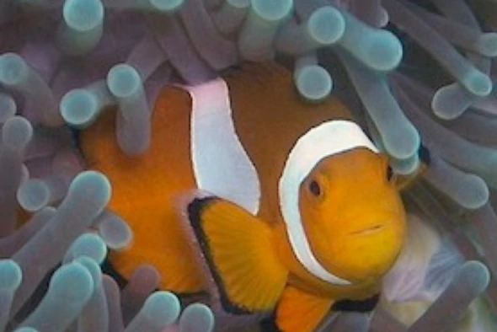
Food Web - Fish
The ability of certain fish, like pollock, to detect predators is decreased in more acidic waters. Recent studies have shown that decreased pH levels also affect the ability of larval clownfish to locate suitable habitat.
When subjected to lower pH levels, the larval clownfish lost their chemosensory ability to distinguish between their favored and protective anemone habitat among the reefs and unfavorable habitats like mangroves.
Additionally, greater acidity impairs their ability to distinguish between the "smell" of their own species and that of predators. These two factors create an increased risk of predation.
When these organisms are at risk, the entire food web may also be at risk.
Notes:
Chemosensory - (of a sense organ or receptor) responsive to chemical stimuli.
Source: http://www.noaa.gov/resource-collections/ocean-acidification

Slide 14
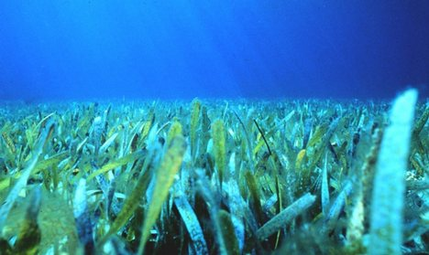
Is there any advantage to higher CO2 levels in our oceans?
While some species will be harmed by ocean acidification, photosynthetic algae and seagrasses may benefit from higher CO₂ conditions in the ocean, as they require CO₂ to live just like plants on land.
Notes:
There are some life forms that may benefit from higher CO2 levels in the ocean.

Slide 15
Our Oceans’ Futures
Estimates of future carbon dioxide levels, based on “business as usual” emission scenarios, indicate that by the end of this century the surface waters of the ocean could be nearly 150% more acidic, resulting in a pH that the oceans haven’t experienced for more than 20 million years.
Ocean acidification is currently affecting the entire world’s oceans, including coastal estuaries and waterways.
Today, more than a billion people worldwide rely on food from the ocean as their primary source of protein.
  Approximately 20% of the world’s population derives at least 1/5 of its animal protein intake from fish.
  Many jobs and economies in the U.S. and around the world depend on the fish and shellfish that live in the ocean.
Notes:
Our oceans are a source of food and jobs for many people in the world.
Source: http://www.noaa.gov/resource-collections/ocean-acidification

Slide 16
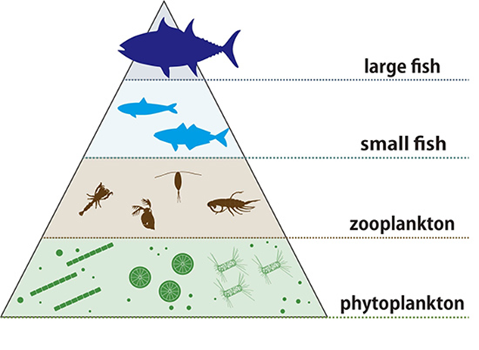
What is Next?
Because sustained efforts to monitor ocean acidification worldwide are only beginning, it is currently impossible to predict exactly how ocean acidification impacts will cascade throughout the marine food chain and affect the overall structure of marine ecosystems.
With the pace of ocean acidification accelerating, scientists, resource managers, and policymakers recognize the urgent need to strengthen the science as a basis for sound decision making and action.
Notes:
Early pH monitoring was not widespread or reliable in the oceans. In the last 20 – 30 years data has become more reliable. New data and trends must continue to be studied to plot a course of action for the future.
Source: http://www.noaa.gov/resource-collections/ocean-acidification
Figure: http://www.jamstec.go.jp/e/about/press_release/20161019/

Slide 17
www.maine.gov/dep

