Slide 1
Renewable Energy
Education Curriculum
Middle School
MAINE DEPARTMENT OF ENVIRONMENTAL PROTECTION
Protecting Maine’s Air, Land and Water

Slide 2

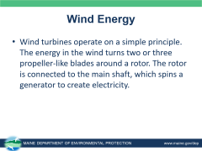
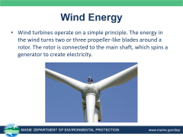
What is Renewable Energy?
Notes:
Renewable energy is energy that is collected from renewable resources, which are naturally replenished on a human timescale, such as sunlight, wind, tides, waves and geothermal heat. Waste-to-energy and anaerobic digestion are also done, but not discussed in detail here.
Waste – to – energy – Using waste as an energy source to generate electricity or heat; it is also a waste reduction method.
Anaerobic Digestions (biogas) - Anaerobic digestion is a biological process that produces a gas principally composed of methane (CH4) and carbon dioxide (CO₂) otherwise known as biogas. These gases are produced from organic wastes such as livestock manure, food processing waste, etc and these gases can be used for process heating or electrical generation. Source: http://www.energy.ca.gov/biomass/anaerobic.html
Non-Renewable Energy – Most of the energy consumed in the U.S. is from non-renewable energy sources: petroleum products, hydrocarbon gas liquids, natural gas, coal, and nuclear energy.
Source: https://en.wikipedia.org/wiki/Renewable_energy
Photo Source: http://www.entrypoint.cz/files/2814/4240/8640/questions-reponses-profits.jpg

Slide 3
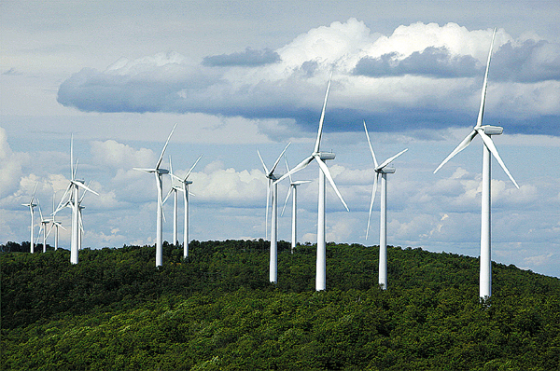
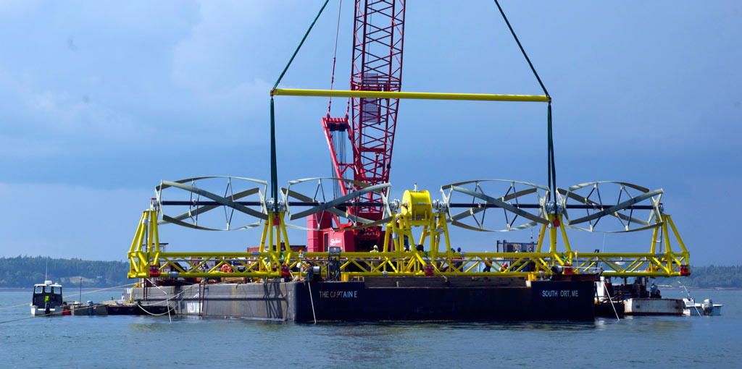
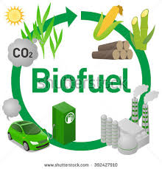
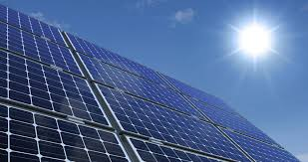
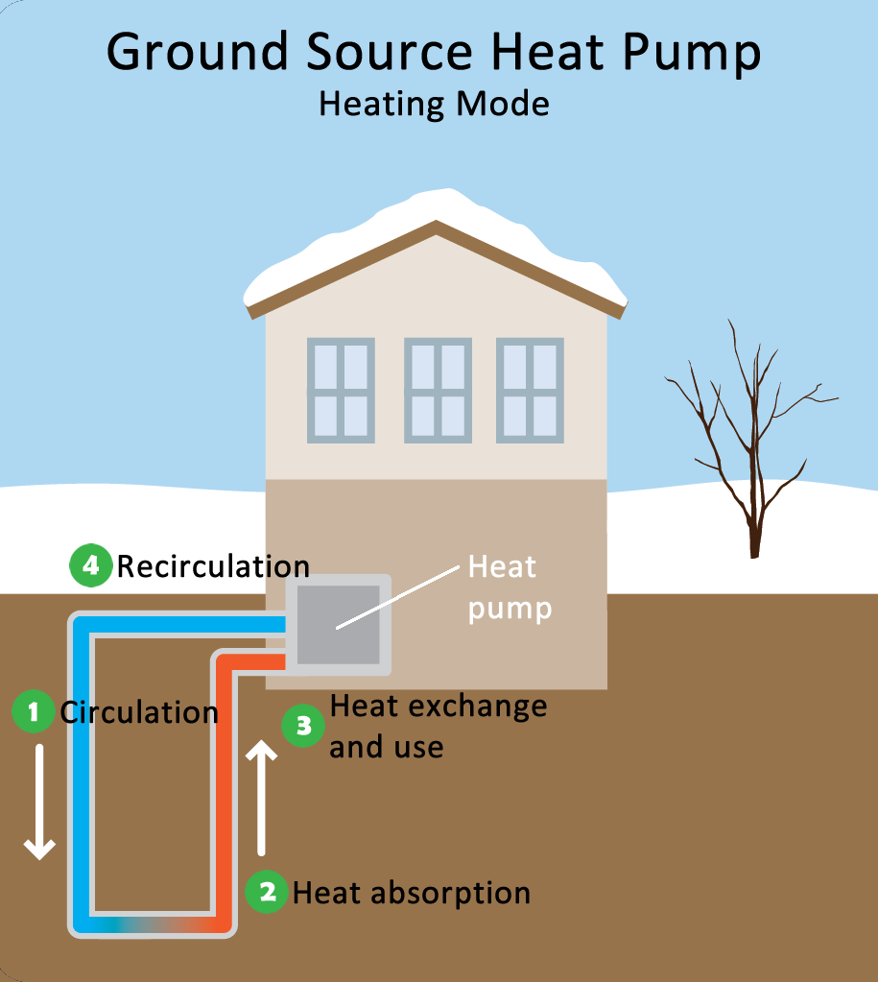
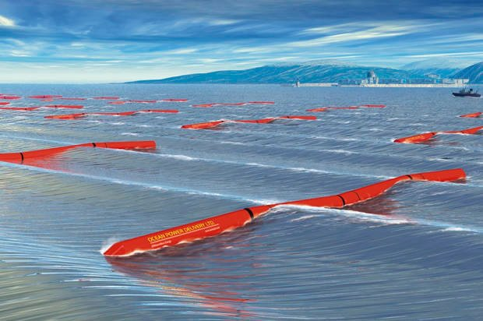
Renewable Energy
Notes:
Photos clockwise (starting top left) – wind turbines, water tidal turbines, wave energy, geothermal energy, solar panels, biofuels
Source: wind - https://bdn-data.s3.amazonaws.com/uploads/2009/09/1251860949_2543.jpg, solar - http://solaroregon.org/wp-content/uploads/2015/12/solar-panel-energy-orgeon-850x450_c.jpg, tidal energy - http://tidalenergytoday.com/wp-content/uploads/2017/01/orpc-shows-progress-on-maine-tidal-project.jpg, wave - https://media.salon.com/2016/08/wave_harvesters-620x412.jpg, https://www.epa.gov/sites/production/files/styles/large/public/2014-11/heat-pump-heating.pn, biofuel - https://wattsupwiththat.files.wordpress.com/2011/04/biofuellifecycle11.jpg

Slide 4
Renewable Energy
Maine is endowed with plentiful bioenergy, wind, hydropower, ocean, and other renewable energy resources.
Non-hydro renewables are responsible for 32% of in-state generation, a higher percentage than in any other state in the nation.
Notes:
Source: http://www.acore.org/files/pdfs/states/Maine.pdf

Slide 5
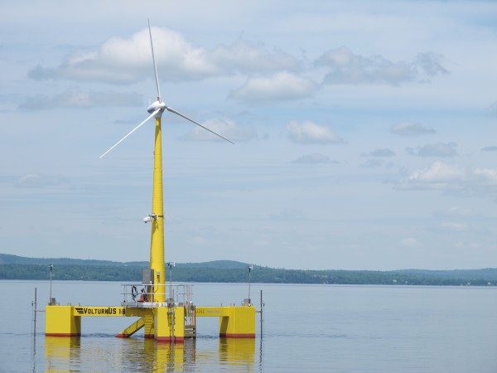
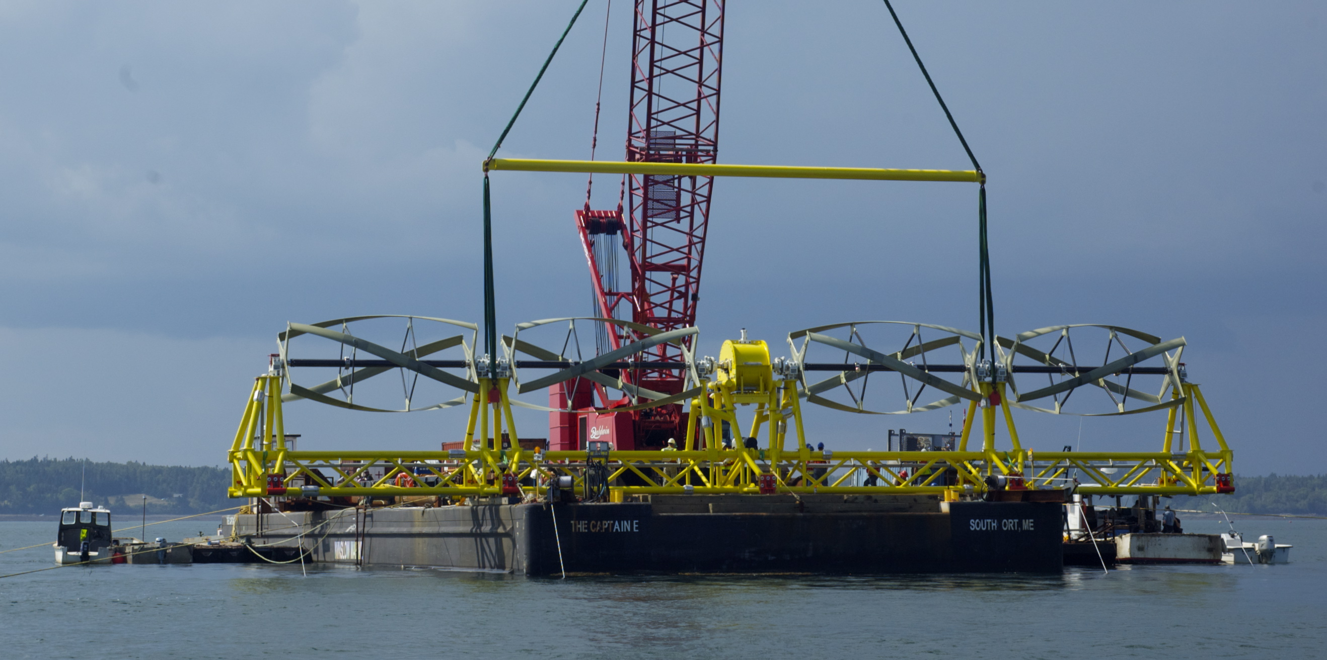
Renewable Energy
Maine is home to the country’s first tidal energy device to generate electricity for the power grid and first working offshore wind turbine (as of 2014).
Notes:
The tidal device (left photo) is stationed on the bottom of Cobscook Bay (Downeast Maine) and can power approximately 30 homes. The floating offshore wind turbine is 65 feet high and can power five homes. It was tested off of Castine, Maine.
Source: http://www.acore.org/files/pdfs/states/Maine.pdf Photo: wind turbine - https://bdn-data.s3.amazonaws.com/uploads/2013/07/10025241_H10688622-600x450.jpg

Slide 6
Solar Energy
We use solar thermal energy systems to
heat water for use in homes, buildings, or swimming pools
heat the inside of homes, greenhouses, and other buildings
heat fluids to high temperatures in solar thermal power plants
Solar photovoltaic devices, or solar cells, change sunlight directly into electricity.
Notes:
Source: https://www.eia.gov/energyexplained/index.cfm?page=solar_home

Slide 7
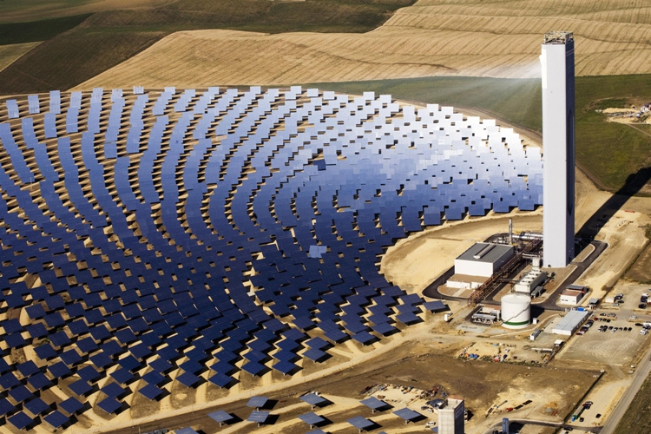
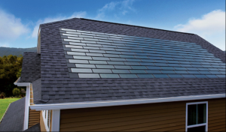
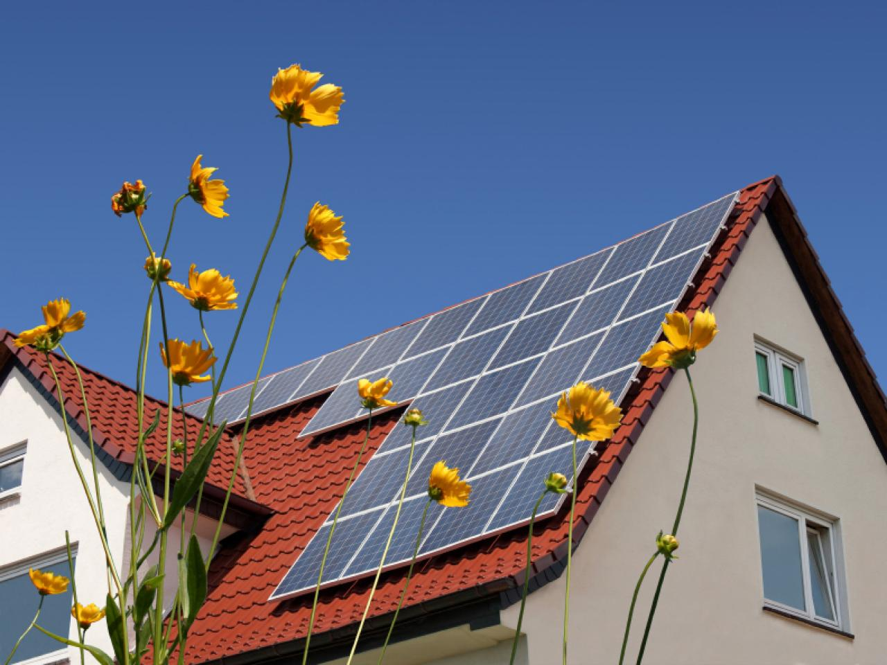
Solar Energy
Notes:
Photo Top Left – Solar Tower - The Sun’s light is focused onto a small area using mirrors. The mirrors constantly follow the Sun as it moves through the sky. They do this to make sure they are receiving as much light as possible.
The beam created by all of these reflecting mirrors is used to heat a liquid to an extremely hot temperature—sometimes over 1000°F! This liquid is a chemical that is very good at trapping heat. After it is heated, the liquid is pumped through a tank of water in a pipe. These hot pipes cause the water to boil and create steam. This steam spins a turbine, which powers a generator. Sometimes, the hot liquid itself is used to power the generator.
Source: https://climatekids.nasa.gov/concentrating-solar/
Photo Middle - shingles: http://news.energysage.com/wp-content/uploads/2016/08/Dow-solar-shingles-300x176.png
Photo Right - Solar panels on roof: http://hgtvhome.sndimg.com/content/dam/images/hgrm/fullset/2011/7/26/1/iStock-13689706_solar-panels-on-roof_s4x3.jpg.rend.hgtvcom.1280.960.suffix/1409157922480.jpeg

Slide 8
Solar Energy
The two main benefits of using solar energy are
Systems do not produce air pollutants or carbon dioxide.
Systems on buildings have minimal impact on the environment.
The main limitations of solar energy are
The amount of sunlight that arrives at the earth's surface is not constant. The amount of sunlight varies depending on location, time of day, season of the year, and weather conditions.
The amount of sunlight reaching a square foot of the earth's surface is relatively small, so a large surface area is necessary to absorb or collect a useful amount of energy.
Notes:
Source: https://www.eia.gov/energyexplained/index.cfm?page=solar_home

Slide 9
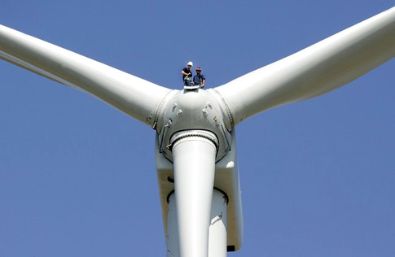
Wind Energy
Wind turbines operate on a simple principle. The energy in the wind turns two or three propeller-like blades around a rotor. The rotor is connected to the main shaft, which spins a generator to create electricity.
Notes:
Source: https://energy.gov/eere/wind/animation-how-wind-turbine-works
Photo: https://metaefficient.com/news/the-tallest-wind-turbines-in-the-us-installed-in-texas.html (1.5MW turbine in Texas)

Slide 10
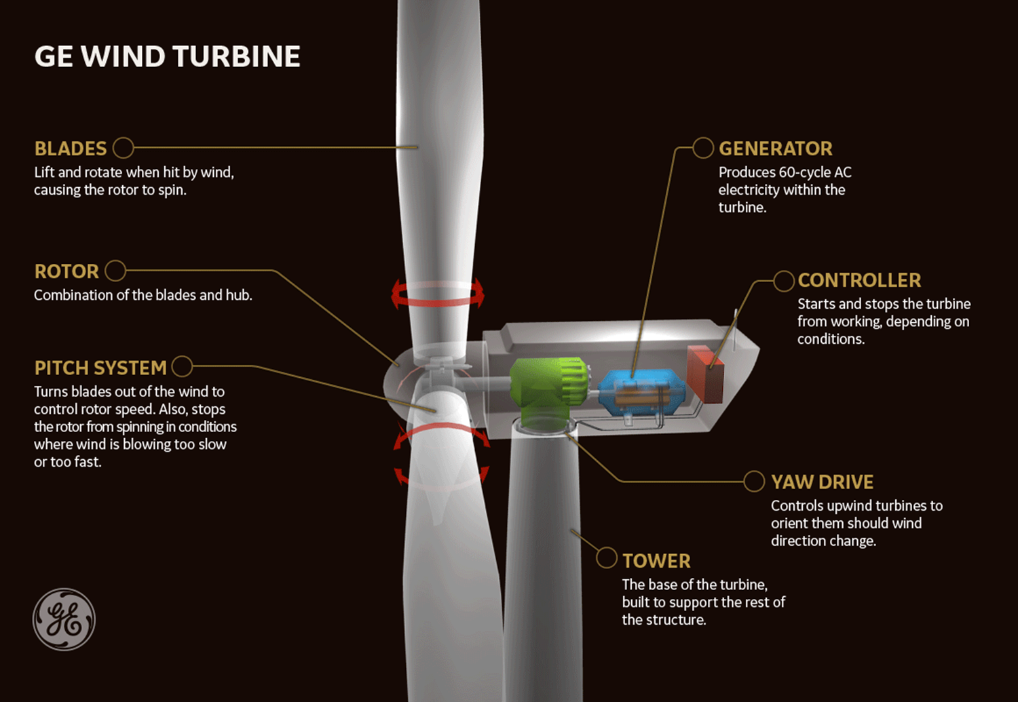
Wind Energy
Notes:
Yaw –a twisting or oscillation of a moving ship or aircraft around a vertical axis.
Pitch - a swaying or oscillation around a horizontal axis perpendicular to the direction of motion
Source:
https://www.gerenewableenergy.com/content/dam/gepower-renewables/global/en_US/images/body-images/onshore-wind/GE-turbine.gif

Slide 11
Wind Energy
Wind turbines are mounted on a tower to capture the most energy. At 100 feet or more above ground, they can take advantage of faster and less turbulent wind.
Wind turbines can be used to produce electricity for a single home or building, or they can be connected to an electricity grid for more widespread electricity distribution.
Notes:
Source: https://energy.gov/eere/wind/animation-how-wind-turbine-works

Slide 12
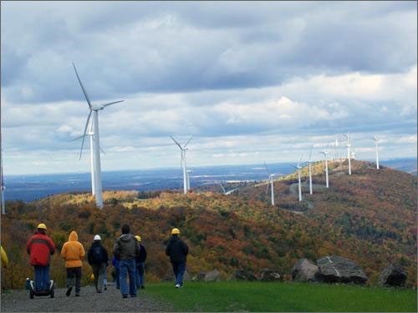
Wind Energy
Advantages of Wind Energy
  Clean and renewable source of power
  Cost effective
  Rapid growth of industry, large potential
Disadvantages of Wind Energy
  Wind reliability
  Threat to wildlife
  Noise and visual pollution
Notes:
https://www.conserve-energy-future.com/pros-and-cons-of-wind-energy.php
Mars Hill Wind Farm Photo Source: https://www.nrel.gov/news/features/images/20091120_states_15332_large.jpg

Slide 13
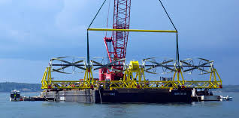
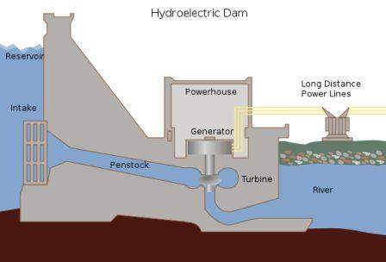
Tidal Energy
Tidal Stream Generator
  Makes use of the kinetic energy of moving water to power turbines, in a similar way to wind turbines that use wind to power turbines.
Tidal Barrage
  Tidal barrages make use of the potential energy in the difference in height between high and low tides.
Notes:
The world's first large-scale tidal power plant was the Rance Tidal Power Station in France, which became operational in 1966
Tidal Stream Generator - Some tidal generators can be built into the structures of existing bridges or are entirely submersed, thus avoiding concerns over impact on the natural landscape.
Tidal Barrage - When using tidal barrages to generate power, the potential energy from a tide is seized through strategic placement of specialized dams. When the sea level rises and the tide begins to come in, the temporary increase in tidal power is channeled into a large basin behind the dam, holding a large amount of potential energy. With the receding tide, this energy is then converted into mechanical energy as the water is released through large turbines that create electrical power through the use of generators.
There are other types tried as well…
https://en.wikipedia.org/wiki/Tidal_power Photo: tidayenergytoday.com,

Slide 14
Tidal Energy
Advantages
  Clean fuel source compared to fossil fuels
  Domestic source of energy
Disadvantages
  Tidal power can have effects on marine life.
    The turbines can accidentally kill swimming sea life with the rotating blades.
    Some fish may no longer utilize the area if threatened with a constant rotating or noise-making object.
    Installing a barrage may change the shoreline within the bay or estuary, affecting a large ecosystem that depends on tidal flats.
Notes:
Disadvantages - Inhibiting the flow of water in and out of the bay, there may also be less flushing of the bay or estuary, causing additional turbidity (suspended solids) and less saltwater, which may result in the death of fish that act as a vital food source to birds and mammals. Migrating fish may also be unable to access breeding streams, and may attempt to pass through the turbines. The same acoustic concerns apply to tidal barrages
https://en.wikipedia.org/wiki/Tidal_power

Slide 15
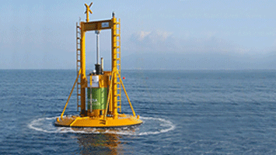
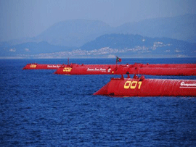
Wave Energy
Ocean waves contain tremendous energy potential.
Wave power devices extract energy from the surface motion of ocean waves or from pressure fluctuations below the surface.
Notes:
https://www.boem.gov/Ocean-Wave-Energy/
Several types are shown….
Photos: Ocean Power Technology's (OPT) Powerbuoy wave generation system (left) A point absorber is a floating structure with components that move relative to each other due to wave action (e.g., a floating buoy inside a fixed cylinder). Point absorbers often look like floating oceanographic buoys. They utilize the rise and fall of the wave height at a single point for energy conversion. The relative up and down bobbing motion caused by passing waves is used to drive electromechanical or hydraulic energy converters to generate power.
Right - The Agucadoura Wave Farm offshore Portugal was the world's first. It was tested and operated in 2008. 3 miles offshore, using the Pelamus Wave Energy Conversion Device. Attenuators are long multisegment floating structures oriented parallel to the direction of the waves. They ride the waves like a ship, extracting energy by using restraints at the bow of the device and along its length. The differing heights of waves along the length of the device causes flexing where the segments connect. The segments are connected to hydraulic pumps or other converters to generate power as the waves move across.

Slide 16

Wave Energy
Advantages
  Renewable
  Environmentally friendly compared to fossil fuel energy
  Variety of designs to use
  Less energy dependence from foreign governments
Disadvantages
  Can affect the marine environment
  May disturb private or commercial shipping
  Dependent on wavelength for best operation
  Poor performance in rough weather
  Visual/noise issues
Notes:
https://www.conserve-energy-future.com/advantages_disadvantages_waveenergy.php Image: cliparting.com

Slide 17
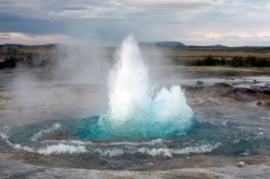
Geothermal Energy
(geo = earth and thermal = heat), geothermal energy comes from heat produced by the Earth.
Notes:
Beneath the surface (or crust) of the Earth, there are a number of heat-producing layers of rock, minerals, and magma, including the mantle, the outer core, and the inner core. The deeper you dig towards the center of the Earth, the hotter it gets. In fact, the core (about 4,000 miles beneath the surface), can reach temperatures of 7,600 degrees Fahrenheit.
This heat – which can be harnessed for energy — is caused by residual heat from the formation of the Earth, as well as decay of radioactive isotopes.
Photo: https://www.google.com/url?sa=i&rct=j&q=&esrc=s&source=images&cd=&cad=rja&uact=8&ved=0ahUKEwietIHxparXAhWFNxQKHWyEAZcQjB0IBg&url=http%3A%2F%2Fwww.alternativeenergyprimer.com%2FGeothermal-Energy.html&psig=AOvVaw2aib3RNqXcNckTvqZ8XhkH&ust=1510069534519825
Source: https://www.justenergy.com/blog/beneath-our-feet-an-introduction-to-geothermal-energy/

Slide 18
Geothermal Energy
Direct geothermal energy can be accessed in areas where hot springs/geothermal reservoirs are near the surface of the Earth.
Geothermal heat pumps utilizes a series of underground pipes, an electric compressor and a heat exchanger to absorb and transfer heat.
Geothermal power plants also harness the heat of the Earth through hot water and steam. In these plants, heat is used to generate electricity.
Notes:
Direct geothermal energy - . In these areas, hot water (pumped through a heat exchanger) can be directly piped in to heat homes or buildings. The “used” water is then returned to the reservoir for re-heating.
Geothermal heat pumps - In the summer, the system removes heat from the house/building and returns it to the Earth. In the winter, the geothermal pump absorbs heat from the ground and transfers it into the house/building.
Geothermal Power Plants – There are several different kinds of power plants.
Source: https://www.justenergy.com/blog/beneath-our-feet-an-introduction-to-geothermal-energy/

Slide 19
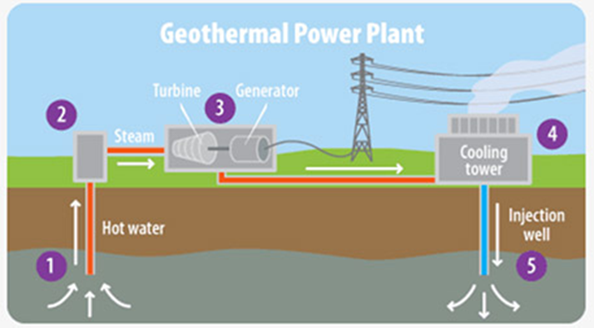
Geothermal Energy
Advantages
  Renewable energy
  Cleaner than burning fossil fuels
Disadvantages
  Cost of drilling, researching proper areas
  Requires a suitable location
Notes:
1 – hot water extracted from the earth, 2 - hot water exposed to lower pressure creates steam, 3 – steam goes through a turbine generator converting thermal energy to mechanical / electrical energy, 4 – in the cooling tower steam is cooled and the condensed water is returned to the earth in 5 - .
Photo https://cdn.vox-cdn.com/uploads/chorus_asset/file/7807505/feature_geothermal_2017_inline1.jpg
Source: https://www.justenergy.com/blog/beneath-our-feet-an-introduction-to-geothermal-energy/

Slide 20
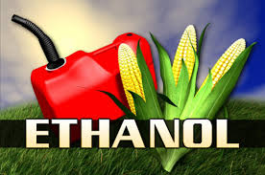
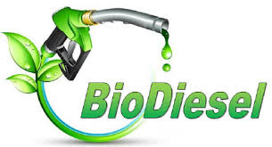
Biofuels
The two most common types of biofuels are ethanol and biodiesel.
Notes:
The two most common types of biofuels are ethanol and biodiesel.
Ethanol is an alcohol, the same found in beer and wine. It is made by fermenting any biomass high in carbohydrates (starches, sugars, or celluloses) through a process similar to brewing beer. Ethanol is mostly used as a fuel additive to cut down a vehicle's carbon monoxide and other smog-causing emissions. But flexible-fuel vehicles, which run on mixtures of gasoline and up to 85% ethanol, are now available.
http://www.renewableenergyworld.com/bioenergy/tech/biofuels.html
Anaerobic Digestions (biogas) - Anaerobic digestion is a biological process that produces a gas principally composed of methane (CH4) and carbon dioxide (CO₂) otherwise known as biogas. These gases are produced from organic wastes such as livestock manure, food processing waste, etc and these gases can be used for process heating or electrical generation. Source: http://www.energy.ca.gov/biomass/anaerobic.html
Photo: https://sites.psu.edu/siowfa16/files/2016/11/cropped-danger-of-ethanol-fuel-2fpvumy.jpg, http://www.duqlawblogs.org/energy/wp-content/uploads/2015/04/biodiesel_logo.jpg

Slide 21
Biofuels
  Ethanol is an alcohol.
  Ethanol is mostly used as a fuel additive to cut down a vehicle's carbon monoxide and other smog-causing emissions.

Slide 22
Biofuels
Biodiesel is made by combining alcohol (usually methanol) with vegetable oil, animal fat, or recycled cooking greases.
It can be used as an additive to reduce vehicle emissions (typically 20%) or in its pure form as a renewable alternative fuel for diesel engines.
Notes:
http://www.renewableenergyworld.com/bioenergy/tech/biofuels.html

Slide 23
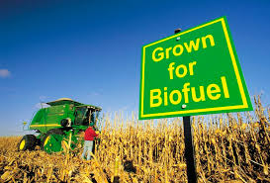
Biofuels
Advantages
  Easy to source
  Renewable
  Reduces greenhouse gases
  Reduced dependence on foreign energy
Disadvantages
  Higher cost of production (lower supply than gasoline)
  Monoculture
  Shortage of food
  Water Use
Notes:
Advantages of Biofuels
Cost Benefit: As of now, biofuels cost the same in the market as gasoline does. However, the overall cost benefit of using them is much higher.
Easy To Source: Biofuels are made from many different sources such as manure, waste from crops and plants grown specifically for the fuel.
3. Renewable: Since most of the sources like manure, corn, switchgrass, soyabeans, waste from crops and plants are renewable and are not likely to run out any time soon, making the use of biofuels efficient in nature. These crops can be replanted again and again.
4. Reduce Greenhouse Gases: Fossil fuels, when burnt, produce large amount of greenhouse gases i.e. carbon dioxide in the atmosphere. These greenhouse gases trap sunlight and cause planet to warm. The burning of coal and oil increases the temperature and causes global warming. To reduce the impact of greenhouse gases, people around the world are using biofuels. Studies suggests that biofuels reduces greenhouse gases up to 65 percent.
5. Economic Security: If more people start shifting towards biofuels, a country can reduce its dependance on fossil fuels. More jobs will be created with a growing biofuel industry, which will keep our economy secure.
6. Reduce Dependence on Foreign Oil: As prices of crude oil is touching sky high, we need some more alternative energy solutions to reduce our dependance on fossil fuels.
7. Lower Levels of Pollution: They release lower levels of carbon dioxide and other emissions when burnt. Although the production of biofuels creates carbon dioxide as a byproduct, it is frequently used to grow the plants that will be converted into the fuel. This allows it to become something close to a self sustaining system.
Disadvantages of Biofuels
High Cost of Production: Even with all the benefits associated with biofuels, they are quite expensive to produce in the current market.
Monoculture: Monoculture refers to practice of producing same crops year after year, rather than producing various crops through a farmer’s fields over time..
3. Use of Fertilizers: Biofuels are produced from crops and these crops need fertilizers to grow better. The downside of using fertilizers is that they can have harmful effects on surrounding environment and may cause water pollution. Fertilizers contain nitrogen and phosphorus. They can be washed away from soil to nearby lake, river or pond.
4. Shortage of Food: Biofuels are extracted from plants and crops that have high levels of sugar in them. However, most of these crops are also used as food crops. Even though waste material from plants can be used as raw material, the requirement for such food crops will still exist. It will take up agricultural space from other crops, which can create a number of problems. Even if it does not cause an acute shortage of food, it will definitely put pressure on the current growth of crops. One major worry being faced by people is that the growing use of biofuels may just mean a rise in food prices as well.
5. Industrial Pollution: The carbon footprint of biofuels is less than the traditional forms of fuel when burnt. However, the process with which they are produced makes up for that. Production is largely dependent on lots of water and oil
6. Water Use: Large quantities of water are required to irrigate the biofuel crops and it may impose strain on local and regional water resources, if not managed wisely.
7. Future Rise in Price: Current technology being employed for the production of biofuels is not as efficient as it should be. Scientists are engaged in developing better means by which we can extract this fuel.
https://www.conserve-energy-future.com/advantages-and-disadvantages-of-biofuels.php Photo: https://fthmb.tqn.com/WTp44xEkgdQJs0QEDk1V50y-5OQ=/768x0/filters:no_upscale()/177680720-56a2ad2a3df78cf77278b56e.jpg

Slide 24
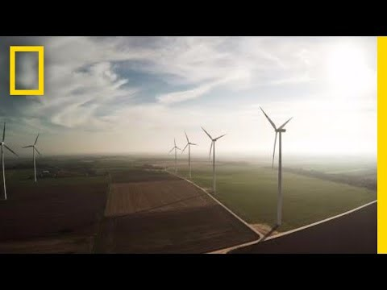
Renewable Energy 101
National Geographic (~3:17)
Notes:
Source: Youtube - https://www.youtube.com/watch?v=1kUE0BZtTRc

Slide 25

www.maine.gov/dep

