Slide 1
Solid Waste, Recycling, & Trash to Energy
Education Curriculum
Sixth Grade Program
MAINE DEPARTMENT OF ENVIRONMENTAL PROTECTION
Protecting Maine’s Air, Land and Water

Slide 2
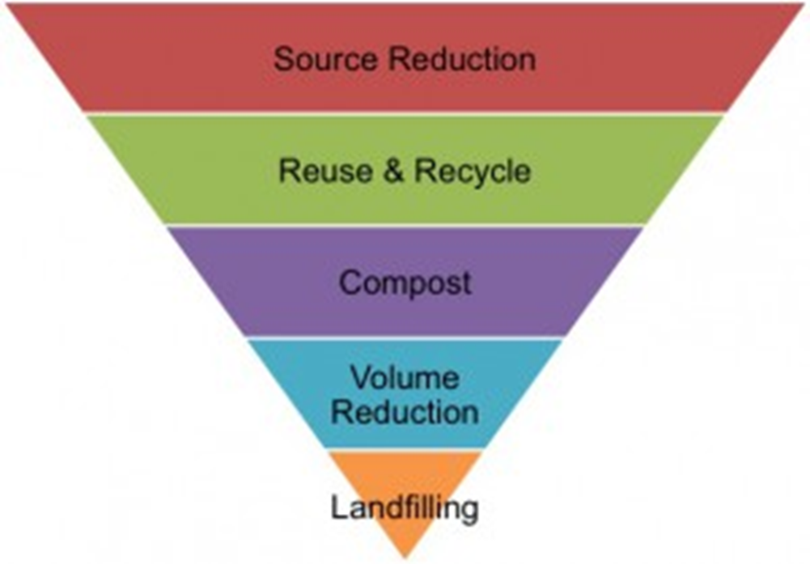

Waste Hierarchy
MAINE DEPARTMENT OF ENVIRONMENTAL PROTECTION www.maine.gov/dep
Notes:
https://en.wikipedia.org/wiki/Waste_minimisation

Slide 3
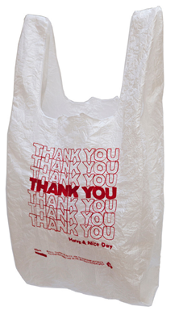
Reduce / Waste Minimization
The best way to deal with trash is to not have any!
Reducing the amount of trash you have to throw out actually prevents waste from piling up in the first place.
To reduce your waste, avoid unnecessary packaging and items designed to be used only once.
  Reduce the need for ’single use’ plastic bags by bringing your own bags when you shop, and use a travel mug when you buy coffee.
  Choose durable, reusable products to make less trash.
MAINE DEPARTMENT OF ENVIRONMENTAL PROTECTION www.maine.gov/dep
Notes:
The waste hierarchy is a set of priorities for the efficient use of resources. Source: http://www.epa.nsw.gov.au/wastestrategy/waste-hierarchy.htm
http://www.maine.gov/dep/sustainability/sw-hierarchy.html
trash bag photo: https://wattsupwiththat.com/2014/02/12/those-much-maligned-plastic-grocery-bags-can-run-your-diesel-truck-or-car/

Slide 4

Reuse
Reusing items can save energy and money, and prolong the item’s useful life.
Extend the life of items you buy by reusing them.
  For example, reuse containers and jars, and donate still usable household goods and clothing to charity.
Notes:
http://www.maine.gov/dep/sustainability/sw-hierarchy.html
Photo: donation - http://bargainbabe.com/donation-pick-up/

Slide 5

Recycle
Every day we use products made from recycled materials.
Take your glass, cans, newspapers, milk jugs and other acceptable recyclable items to your local transfer station, drop off location or place out for curbside collection so that they can be turned into new products like fleece jackets,
Frisbees, paper products, and soda cans. Recycling saves money, energy, and the environment.
36.76% of Maine's municipal solid waste was recycled in 2015.
Notes:
http://www.maine.gov/dep/sustainability/sw-hierarchy.htmlWorld photo: pintrest,
Recycling of products and materials has many benefits and is an important component in achieving sustainable systems. By recycling products and materials, air and water pollution from waste disposal activities are reduced, and the recapturing of those products and materials lessens the amount of mining and extraction of minerals needed to manufacture new products. Additionally, energy and water consumption is decreased in many manufacturing processes. Many recyclable materials have commodity value, which provides additional incentive to their recovery. Maine DEP provides technical and educational assistance to residents, municipalities, schools and businesses to help increase the amount of resources that are recovered from the waste stream. DEP also collects, synthesizes, and reports data on solid waste management in Maine. Source: http://www.maine.gov/dep/waste/recycle/

Slide 6
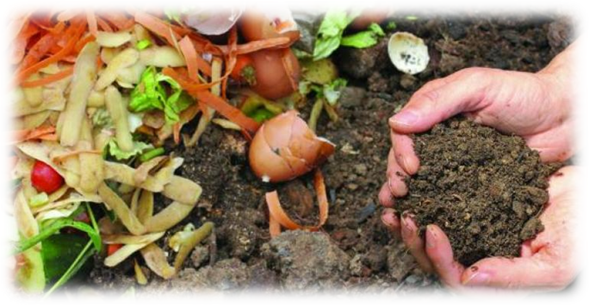
Compost
Composting is nature's way of recycling organics.
When you compost, you convert vegetable scraps, leaves, grass clippings and other materials into a nutrient rich soil material.
You can use finished compost in your garden and around shrubs or other plants to help them grow.
Composting also reduces the amount of materials that need to be disposed of, reducing those related costs.
Notes:
http://www.maine.gov/dep/sustainability/sw-hierarchy.html
Photo: http://www.waste360.com/waste-energy/food-waste-recycling-energy-program-launches-portland-maine

Slide 7
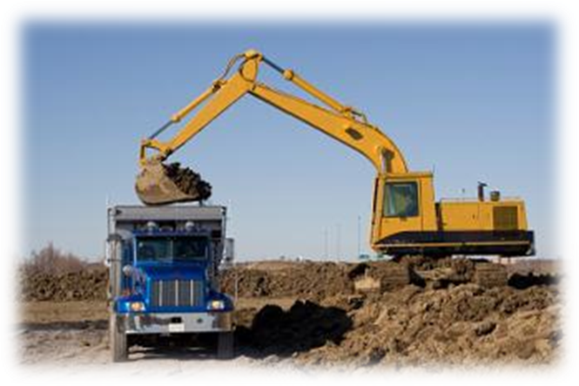
Processing and Beneficial Use
Processing reduces the volume of materials to be landfilled and can create products such as fuel oils and steam for electricity generation.
Beneficial use means the reuse of solid waste as a substitute for raw material in manufacturing, as construction material or fill, as a fuel, or as an agronomic soil amendment.
Notes:
http://www.maine.gov/dep/sustainability/sw-hierarchy.html
Photo: http://www.esol.net/fillconversions/fillconversions.htm

Slide 8
Waste-To-Energy
Waste-to-Energy facilities accept our solid waste and combust it at very high temperatures, producing heat that is used to convert water into steam. The steam is used to run turbines that generate electricity.
Scrubbers, filters, and other pollution control equipment reduce pollutants released during the incineration process. Ash and other residues from this process are landfilled.
Over 27% of Maine's municipal solid waste was combusted in 2015.
Notes:
http://www.maine.gov/dep/sustainability/sw-hierarchy.html

Slide 9
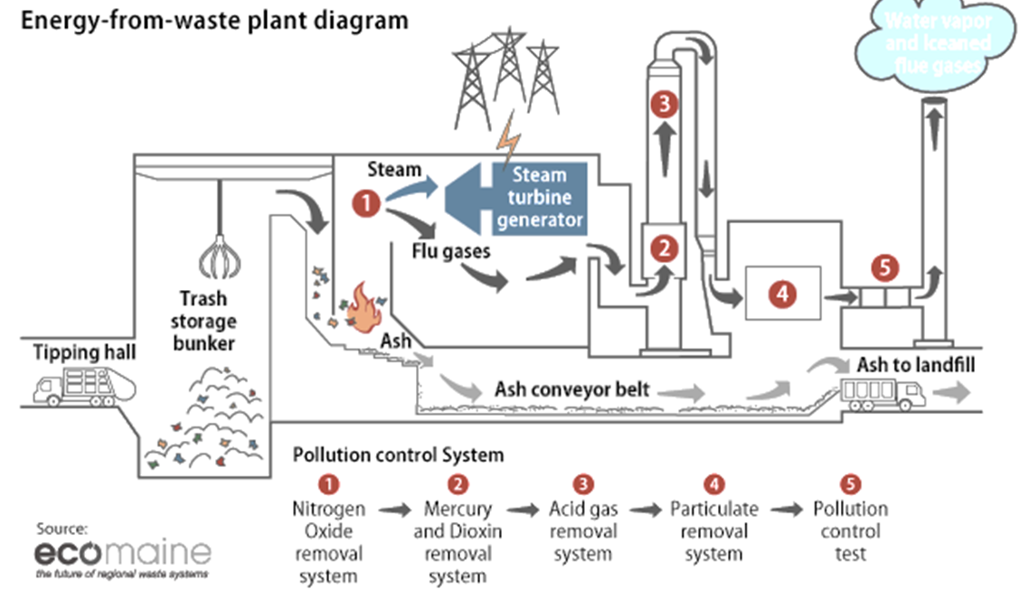
Waste-to Energy
Notes:
https://www.americanprogress.org/issues/green/reports/2013/04/17/60712/energy-from-waste-can-help-curb-greenhouse-gas-emissions/
The first incinerator in the United States was built in 1885 on Governors Island in New York, NY. Source: https://www.epa.gov/smm/energy-recovery-combustion-municipal-solid-waste-msw
The upfront money needed to build an MSW combustion facility can be significant and economic benefits may take several years to be fully realized. A new plant typically requires at least 100 million dollars to finance the construction; larger plants may require double to triple that amount. Source: https://www.epa.gov/smm/energy-recovery-combustion-municipal-solid-waste-msw#01

Slide 10
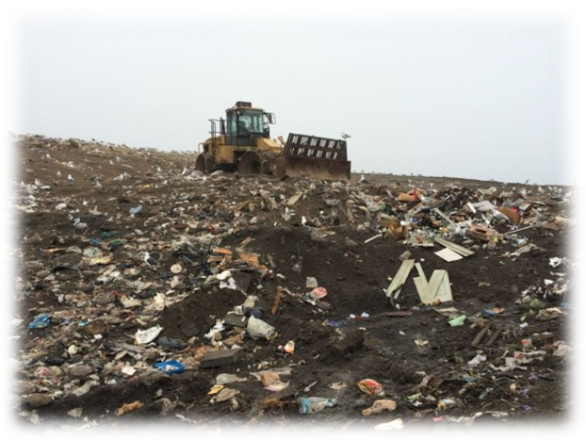
Landfill
Today’s landfills are very different from the old ones where people just dumped their garbage in an open area.
Landfills are constructed and operated to strict environmental standards, including liners to protect groundwater.
Within this hierarchy, landfilling waste is the lowest priority of the solid waste management options.
Notes:
http://www.maine.gov/dep/sustainability/sw-hierarchy.html
Photo:http://bangordailynews.com/2015/08/25/news/midcoast/more-trash-in-bath-requires-additional-landfill-gas-control/

Slide 11
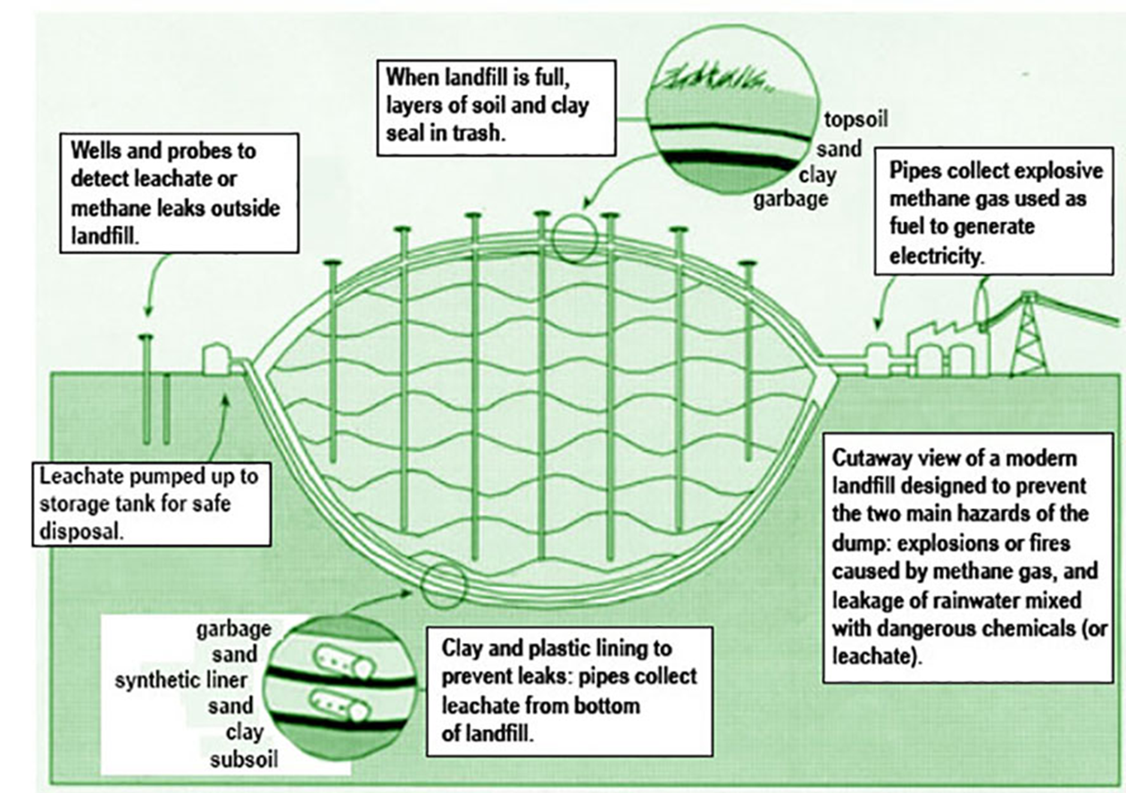
Notes:
https://www.epa.gov/sites/production/files/2016-03/landfillpicjpg_revised2.jpg

Slide 12
Run Time (~7:00)
Pearson Landfills and Recycling Video Field Trip
Notes:
Video: https://vimeo.com/28170420 Pearson Landfills and Recycling Video Field Trip

Slide 13
Add contact information www.maine.gov/dep

