Slide 1
Sustainability
Education Curriculum
Middle School Program
MAINE DEPARTMENT OF ENVIRONMENTAL PROTECTION
Protecting Maine’s Air, Land and Water

Slide 2

What is Sustainability?

Slide 3
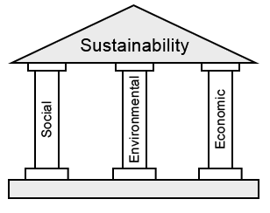
Sustainability
Sustainability is about affording each generation equal opportunity to enjoy undiminished welfare, by comparison to the welfare opportunities available to earlier generations.
Notes:
See Lesson Plan
Sustainability can apply to business, environment, etc. These are three pillars of corporate sustainability. If one of the Pillars of sustainability is weak, the whole system likely becomes less sustainable.
Image source: http://www.berwickmaine.org/index.asp?SEC=E00EE306-F8AD-47E8-94EB-2594BFB992AB&Type=B_BASIC

Slide 4

National Environmental Policy Act of 1969
Committed the United States to sustainability, declaring it a national policy “to create and maintain conditions under which humans and nature can exist in productive harmony, that permit fulfilling the social, economic and other requirements of present and future generations.”
Notes:
A common driver for sustainability efforts is citizens and other stakeholder concerns.
www.epa.gov

Slide 5

EPA’s Strategic Plan (2018-2022)
To Protect Human Health and the Environment
Goal 1 – Core Mission: Deliver real results to provide Americans with clean air, land, and water, and ensure chemical safety.
Goal 2 – Cooperative Federalism: Rebalance the power between Washington and the states to create tangible environmental results for the American people.
Goal 3 – Rule of Law and Process: Administer the law, as Congress intended, to refocus the Agency on its statutory obligations under the law. (www.epa.gov)
Notes:
www.epa.gov

Slide 6
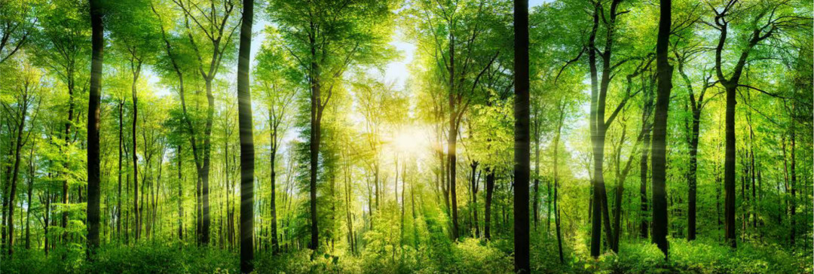
EPA’s Strategic Plan
Energy Efficiency
Green Infrastructure
Sustainable Materials Management
Sustainable Purchasing and Products
Notes:
Energy Efficiency – the goal to reduce the amount of energy required to provide products and services. www.Wikipedia.org.
Green Infrastructure – a cost effective, resilient approach to managing wet weather impacts that provides many community benefits. (stormwater control etc by allowing non paved, non piped ground to accept the water and soak it in; using trees for shade to lower ac costs, or as wind breaks to reduce heating costs in winter etc.)
Sustainable Materials management (SMM) is a systematic approach to using and reusing materials more productively over their entire life cycles. By looking at the entire life cycle we can find new opportunities to reduce environmental impacts, conserve resources, and reduce costs.
Sustainable Purchasing and Products – You can help by buying greener products and services for your home, business, or school.
Photo: http://mc.services/wp-content/uploads/2015/12/green-initiative-page.jpg
www.epa.gov

Slide 7

How do we measure sustainability?
According to Bryan Norton…
Weak Sustainability
  Based on the idea that what we owe the future is to avoid actions that will make them poorer than we are in terms of opportunities to achieve welfare equal to ours.
  Each generation is required to maintain and pass on the economic capital they have inherited.
  No environmental goals should be given priority over other investments that have greater expectations of return in terms of capital accumulation.

Slide 8
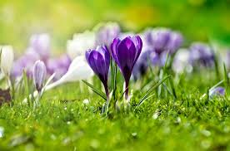
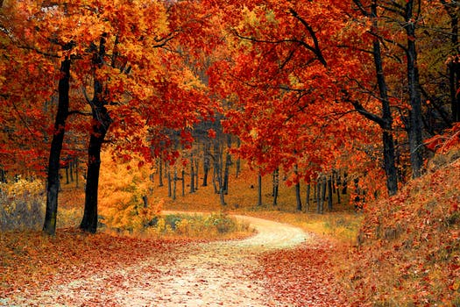
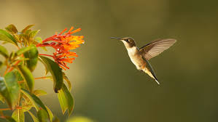

How do we measure sustainability?
According to Bryan Norton…
Strong sustainability
  Incorporates a category of social value - called “natural” capital.
  This capital is not created by humans.
  This capital is deemed essential to the well-being of the people of the future.
  Requires the protection of natural capital to be passed to the next generation.
Notes:
Photo: greens, planwallpaper.com, hummingbird pbs.org, flowers pixabay.com

Slide 9

How do we measure sustainability?
According to Bryan Norton…
What items have value to be passed to the next generation?
This depends on who you ask…
  Financial assets?
  Technology?
  Labor?
  Natural resources?
Some people feel these items are all interchangeable.
Notes:
Discuss with the students what they think is appropriate and important to pass on to the next generation. What do they want passed on to them?
Photo: https://www.sciencedaily.com/images/2014/06/140625132356_1_900x600.jpg

Slide 10

How do we measure sustainability?
According to Bryan Norton…
Some feel that because we do not know what people in the future will want, and because resources are intersubstitutable anyway all we can be expected to do is to avoid impoverishing the future by over-consuming and under-saving.
Notes:
What do students feel we should pass on? What do they wish will be passed on to them?
Photo: https://krobinsonphil4302.files.wordpress.com/2014/12/green-technology-header-2.jpg

Slide 11
How do we measure sustainability?
According to Bryan Norton…
Most mainstream economists and many philosophers prescribe to what Norton calls the “Grand Simplification”
  By stating we are ignorant of the future’s wants this wipes away any specific obligations beyond the next generation.
  As technologies change we can’t know what resources will be crucial to future generations…so we need not act.
Notes:
Ask students if they agree with this “Grand Simplification”. Do they have an idea what future generations will want? How might technological advances make future generations want/need different items than current generations want?

Slide 12
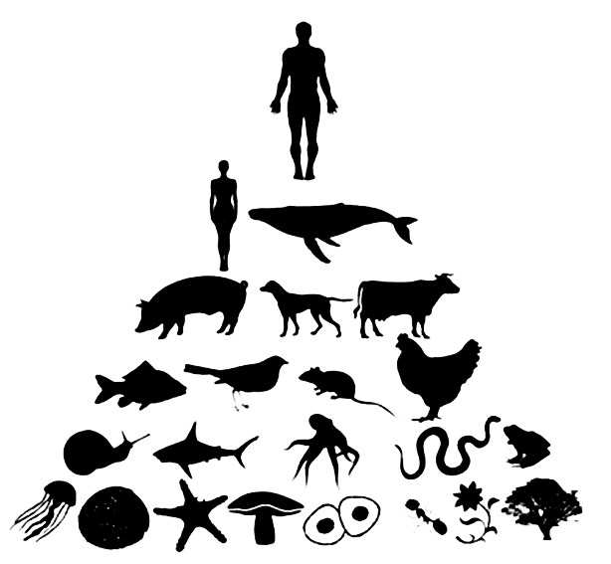
Anthropocentric versus
Non-anthropocentric Viewpoints
Anthropocentric – humans are considered to be the center, with others items put on earth for the humans use.
Notes:
Often times there is a feeling or belief that the items have no value of their own, unless the humans value them ~ no intrinsic value. Humans can be considered to be at the center of everything, or as shown here – at the top of the pyramid.

Slide 13
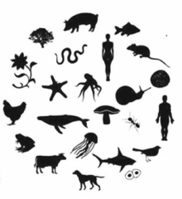
Anthropocentric versus
Non-anthropocentric Viewpoints
Non-anthropocentric
  Humans are not considered the center
  Is it really possible to have a non-anthropocentric view if the viewer is human?
Notes:
How do students feel about this model? Do they feel it more accurately represents what is happening naturally in the world or no?
Photo: https://dripley91.files.wordpress.com/2013/12/picture-14.png

Slide 14
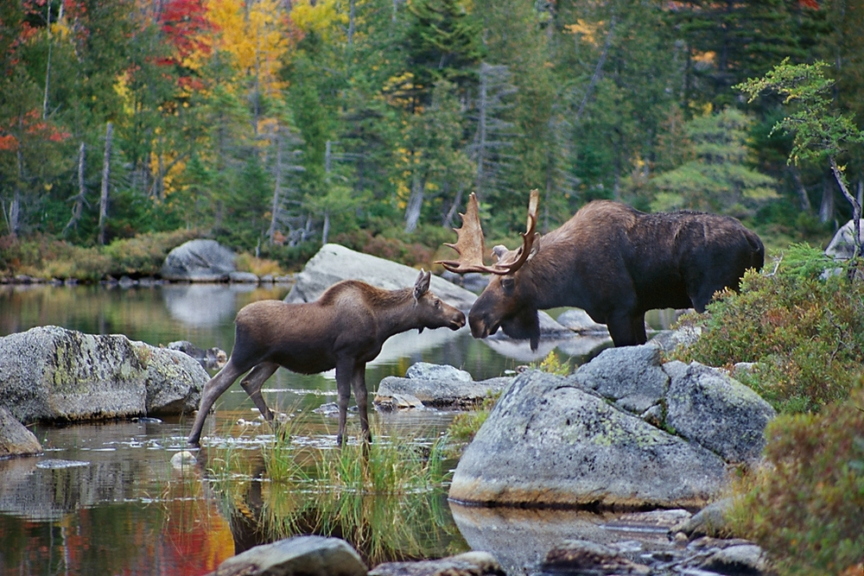
Sustainability
Does nature have intrinsic value?
Does it matter if nature has intrinsic value?
Notes:
Do we have an obligation to protect the future from the negative impacts of our own decisions? Can you think of an example of a decision that a previous generation made in good faith, thinking they were improving life, only to find out later that it was not a good decision? DDT for example?
Do we have an intergenerational obligation?
Photo: https://static1.squarespace.com/static/529ca357e4b0ef97324ed00e/t/562f51bde4b03bac49f2faf9/1445941747168/Maine+Moose+Photography+Tours+and+Workshops

Slide 15
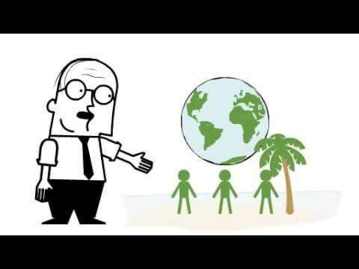
QUICK REVIEW!
Introduction to Sustainability (~2:00)
Notes:
Source: YouTube: https://www.youtube.com/watch?v=B5NiTN0chj0

Slide 16

www.maine.gov/dep

