Slide 1
Watersheds
Education Curriculum
Middle School Program
MAINE DEPARTMENT OF ENVIRONMENTAL PROTECTION
Protecting Maine’s Air, Land and Water
Notes:
https://water.usgs.gov/edu/watershed.html
https://cfpub.epa.gov/surf/state.cfm?statepostal=ME
https://www.epa.gov/hwp/basic-information-and-answers-frequent-questions

Slide 2
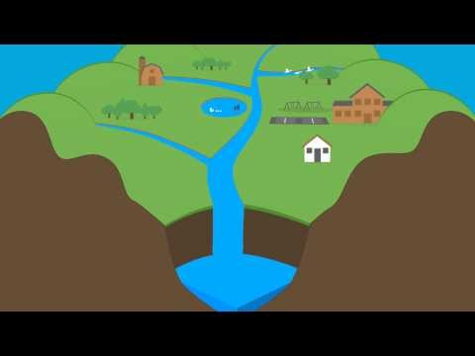

What is a Watershed? (1:17)
MAINE DEPARTMENT OF ENVIRONMENTAL PROTECTION www.maine.gov/dep
Notes:
Video: https://www.youtube.com/watch?v=QOrVotzBNto

Slide 3
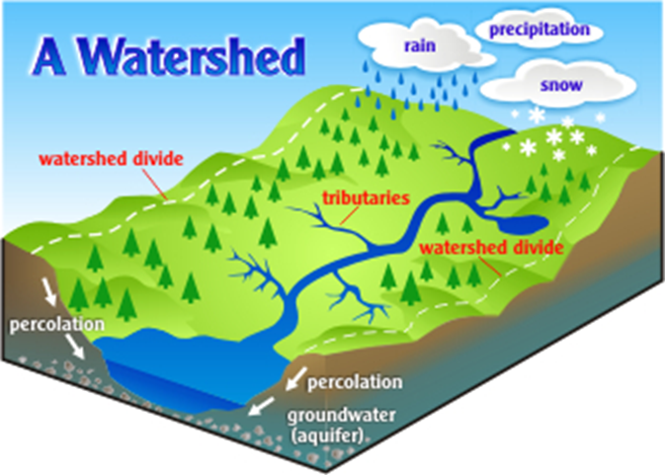
What is a Watershed?
The land area that drains to one stream, lake or river – affects the water quality in the water body that it surrounds.
Because we all live on the land, we all live in a watershed — thus a watershed condition is important to everyone.
MAINE DEPARTMENT OF ENVIRONMENTAL PROTECTION www.maine.gov/dep
Notes:
A watershed –– the land area that drains to streams, lakes and/or rivers – affects the water quality in the water body(s) that it contributes to. The type of land use on the watershed will also affect the water quality. Like water bodies (e.g., lakes, rivers, and streams), individual watersheds share similarities but also differ in many ways.
Photo Source: http://hawp.org/what-is-a-watershed/

Slide 4
What is a Healthy Watershed?
A healthy watershed is one in which natural land cover supports:
  dynamic hydrologic and geomorphologic processes within their natural range of variation,
  habitat of sufficient size and connectivity to support native aquatic and riparian species, and
  physical and chemical water quality conditions able to support healthy biological communities.
Notes:
Natural vegetative cover in the landscape, including the riparian zone, helps maintain the natural flow regime and fluctuations in water levels in lakes and wetlands. This, in turn, helps maintain natural geomorphic processes, such as sediment storage and deposition, that form the basis of aquatic habitats. Connectivity of aquatic and riparian habitats in the longitudinal, lateral, vertical, and temporal dimensions helps ensure the flow of chemical and physical materials and movement of biota among habitats.
A healthy watershed has the structure and function in place to support healthy aquatic ecosystems.
Hydrology
The branch of science concerned with the properties of the earth's water, especially its movement in relation to land.
Geomorphology
The study of the physical features of the surface of the earth and their relation to its geological structures

Slide 5
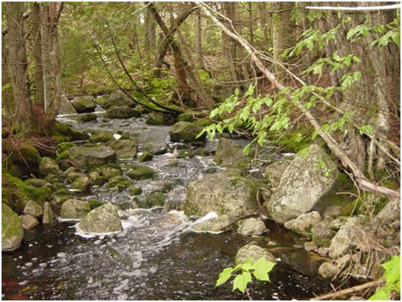
Key Components of a Healthy Watershed
Includes:
  intact and functioning headwater streams, floodplains, riparian corridors;
  natural vegetation in the landscape; and
  hydrology, sediment transport, fluvial geomorphology, and disturbance regimes expected for its location.
Notes:
Fluvial
Of or found in a river.
Photo: Fish and Wildlife Service

Slide 6
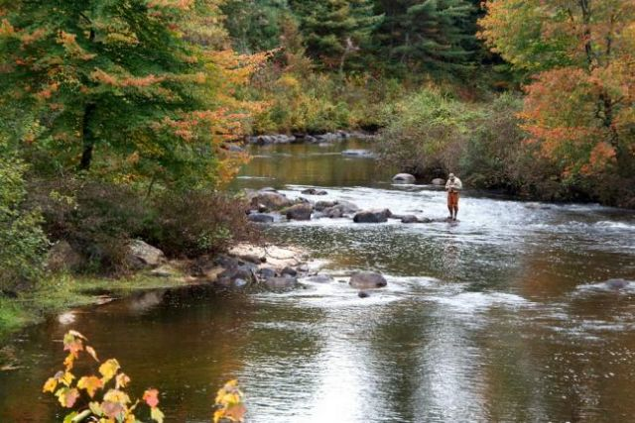
Why Do Watersheds Need to be Protected?
Healthy watersheds not only affect water quality in a good way, but also provide greater benefits to the communities of people and wildlife that live there.
Healthy watersheds provide critical services, such as;
  clean drinking water
  productive fisheries
  outdoor recreation
Notes:
Streams, lakes, rivers, groundwaters and other waters are interconnected with the landscape and all its activities through their watersheds. They are influenced by naturally varying lake levels, water movement to and from groundwater, and amount of stream flow. Other factors, such as forest fires, stormwater runoff patterns, and the location and amount of pollution sources, also influence the health of our waters.
Pollutants in the watershed such as oil leaks from autos, pet wastes, soil erosion from construction sites or agricultural or timber harvesting may all be carried via rain or storm water or snowmelt into the associated water bodies.
Photo: World resources Institute

Slide 7
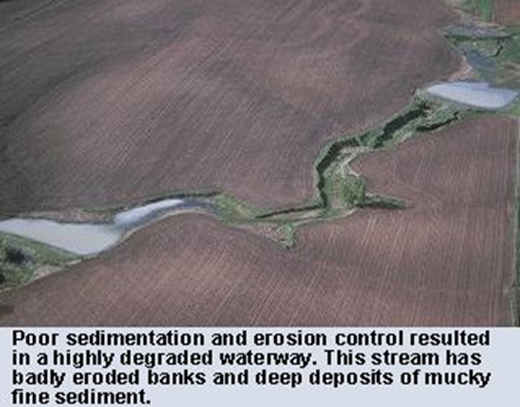
Waterway Degradation
Notes:
Picture: https://cfpub.epa.gov/watertrain/moduleFrame.cfm?parent_object_id=1509

Slide 8
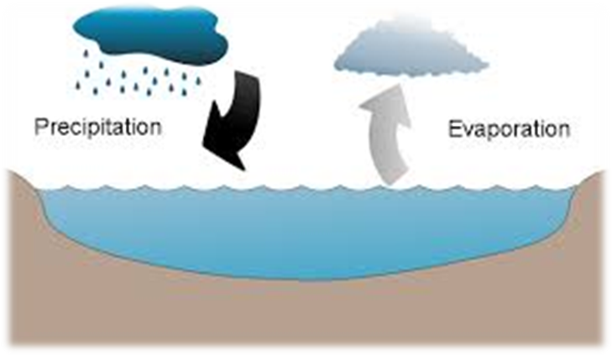
What Factors Influence How Much Water Flows Out of A Watershed?
Precipitation
Infiltration
Evaporation
Transpiration
Storage
Water Use by Humans
Notes:
Photo: http://learnabouttravelmaps.info/pics/i/images-of-precipitation.html

Slide 9
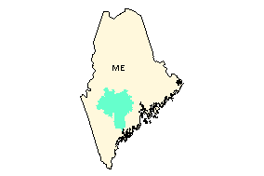
What Watershed do We Live In?
Maine Watersheds

Slide 10
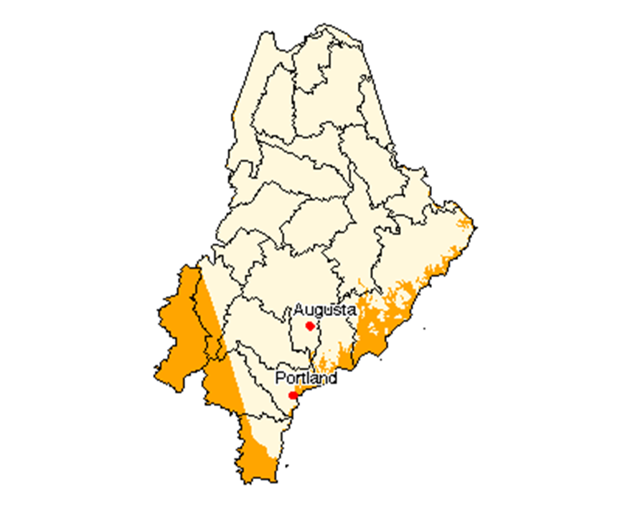
Introduction to Watershed Scavenger Hunt
Notes:
See Lesson Plan

Slide 11
Add contact information www.maine.gov/dep

