Slide 1
Wetlands
Education Curriculum
Sixth Grade Program
MAINE DEPARTMENT OF ENVIRONMENTAL PROTECTION
Protecting Maine’s Air, Land and Water
Notes:
Information from: http://www.maine.gov/dep/water/wetlands/ipwetfv2.html
Photo: Acadia Wetlands, Bill Swindaman 2014

Slide 2
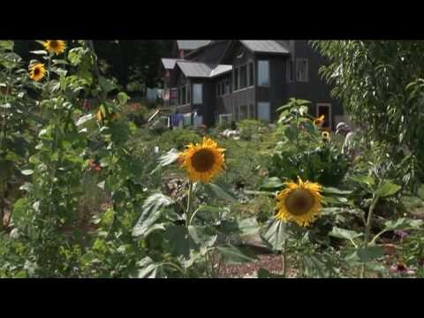
Wetlands and Wonder
(14:02)
Notes:
Video: https://www.youtube.com/watch?v=iX5yT7QSyc4
USEPA - As more Americans dwell in cities and suburbs, our society becomes increasingly distanced from the natural world. This absence of everyday connections to nature has many negative effects-especially for children. Pockets of remaining wetland in developed areas often provide the easiest access to nature. Yet these wetlands may be degraded and go unnoticed. Urban and suburban wetlands are valuable resources to be restored, protected and enjoyed. These remnants of the natural world in the human landscape can play a key role in reconnecting people to nearby nature-thereby improving the health of our children and our communities.

Slide 3
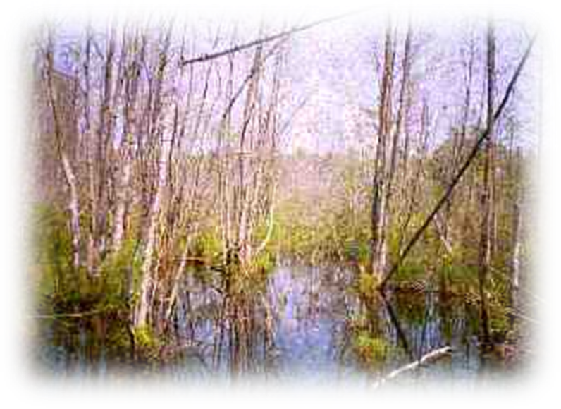
What are Wetlands?
Wetlands are areas where water covers the soil, or is present either at or near the surface of the soil all year or for varying periods of time during the year, including during the growing season.
Notes:
https://www.epa.gov/wetlands/what-wetland, photo: maine.gov

Slide 4
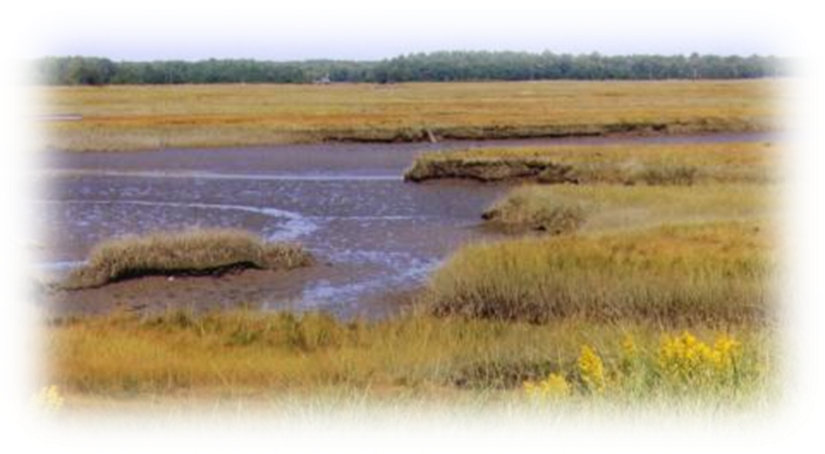
Types of Wetlands in Maine
Over five million acres of Maine's wetlands are freshwater types (wooded swamps, shrub swamps, bogs, freshwater meadows, forested, freshwater marshes and floodplains).
Only 157,500 acres are tidal types (tidal flats, salt marsh, brackish marsh, aquatic beds, beach).
Notes:
http://www.maine.gov/dep/water/wetlands/ipwetfv2.html
Photo Source: http://www.maine.gov/dacf/mnap/features/communities/cattailmarsh.htm –Salt Marsh near Wells, Maine.

Slide 5
What natural functions do wetlands perform?
Wetlands are important to natural systems including
  water storage
  flood conveyance
  groundwater recharge and discharge
  shoreline erosion control and
  water quality improvement.
Wetlands provide habitat vital to fish and wildlife, including many rare and endangered species.
Notes:
http://www.maine.gov/dep/water/wetlands/ipwetfv2.html

Slide 6
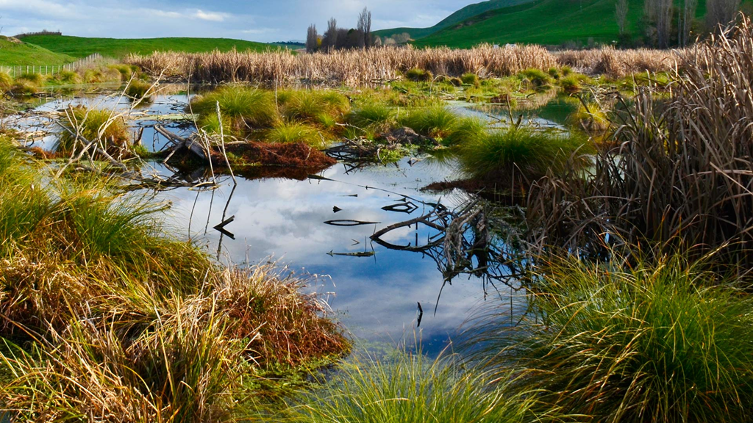
How do wetlands serve as water storage areas?
The capacity of their water retention is associated with the abundant vegetation present in the wetland, where the wetland is located on the land, and the soil type.
Notes:
Photo: http://www.doc.govt.nz/nature/habitats/wetlands/

Slide 7
How do wetlands help to control floods?
Wetlands help to lessen the impacts of flooding by absorbing water and reducing the speed at which flood waters flow.
Upstream wetlands can serve to store flood waters temporarily and release them slowly downstream.
Along rivers, wetlands usually form natural pathways for flood waters from upstream to downstream points.
If those pathways are altered or removed, flood waters can go elsewhere, potentially damaging property and threatening public safety.
Without wetlands as a natural flood control mechanism, flooding can become more severe.

Slide 8
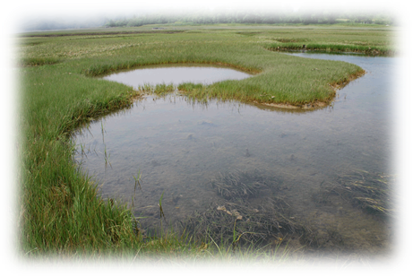
How do wetlands contribute to shoreline erosion control?
  The vegetation found in wetlands along the coast, around lakes and along the shorelines of rivers and streams help to control erosion by
    stabilizing soil,
    encouraging sediment deposit, and
    dampening the effects of wave action.
Notes:
Photo: https://www.seagrant.umaine.edu/coastal-hazards-guide/coastal-wetlands

Slide 9
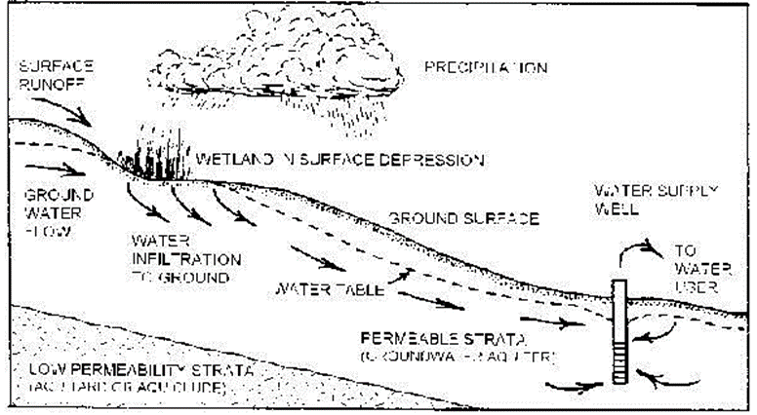
What role do wetlands perform in groundwater recharge and discharge?
Under specific circumstances, wetlands can provide a pathway for surface water to enter and thereby recharge groundwater.
Wetlands also play an important role as the primary natural discharge path of some groundwater aquifers.
Notes:
In a natural cycle, water moves from the atmosphere through rain and other precipitation to surface storage areas in the oceans, rivers and lakes, and to sub-surface storage areas known as groundwater aquifers. In Maine, fully half of the population depends on public or private wells drawing drinking water from such groundwater aquifers.

Slide 10
How do wetlands help to improve water quality?
Wetland vegetation slows water flow and captures sediment suspended in the water, reducing turbidity.
Wetlands filter out, trap and naturally recycle nutrients like nitrogen and phosphorous that run off from the land and might be harmful in excessive quantities in surface waters.
Wetlands can also capture pollutants like heavy metals, organic chemicals like pesticides and petroleum hydrocarbons, removing them at least temporarily and sometimes permanently from aquatic ecosystems.
Notes:
Unfortunately, when wetlands accumulate pollutants, these harmful compounds can also enter the food chain through wetland vegetation and wildlife, ultimately finding their way into fish and wildlife people consume.

Slide 11
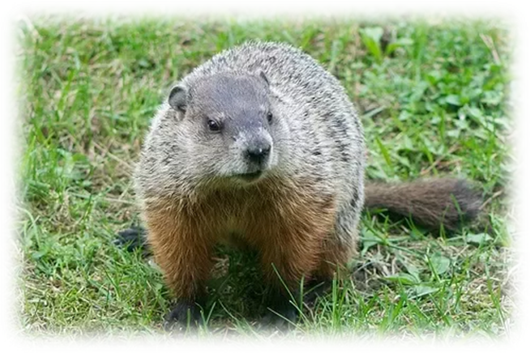
How are wetlands important to fish and wildlife?
With their diverse and abundant vegetation, wetlands support many valuable species of fish and wildlife that thrive only in a wetland habitat.
Still other species that do not inhabit wetlands feed upon fish and wildlife that originate in wetlands.
Notes:
For example, coastal wetlands provide critical habitat for shellfish like clams and mussels and for migratory and nesting shorebirds like sandpipers, plovers and the endangered piping plover. Salt marshes are renowned as duck habitat. Nesting birds like osprey, herons and the endangered bald eagle feed on both freshwater and saltwater wetland species. Certain mammals, including furbearers, live in or near wetlands. Muskrat (in photo), for example, live on wetland banks in houses made from wetland vegetation.

Slide 12
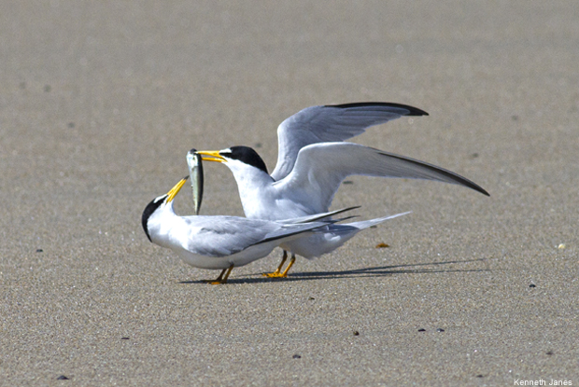
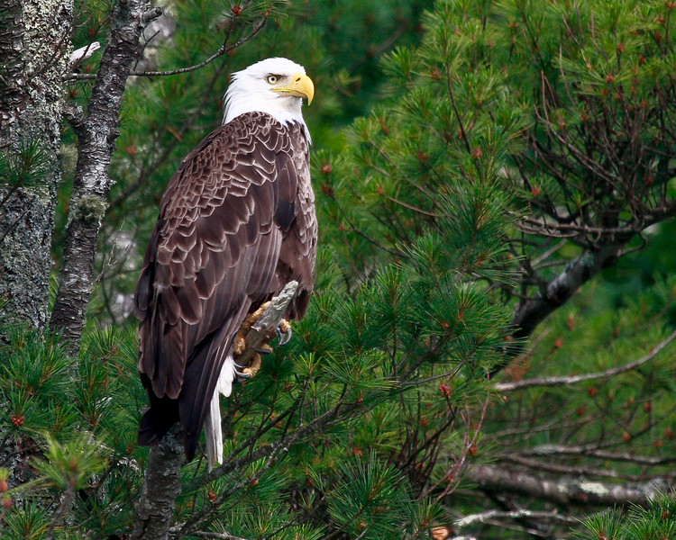
Rare and endangered species that rely upon wetlands
Maine wetlands are treasure troves of many rare plants, including some that botanists once thought extirpated.
Studies of bogs during the 1970s and 1980s, for example, resulted in the discovery of abundant collections of rare orchids that live only in rich wetland habitat.
Certain wetland types are vital to endangered wildlife, including shore birds like the least tern and raptors like the bald eagle which feed in both marine and freshwater wetlands.
Notes:
Photo: USFWS
Eagle Photo: Maine Image Smug-mug

Slide 13
How do wetlands contribute to Maine's economy and quality of life?
Maine's wetlands save millions of dollars annually through erosion control, reduced flood damage and pollution abatement.
Their water quality and flood control functions protect the public from otherwise harmful effects.
Wetlands are also the source of over three million acres of productive timberland, vital to Maine's $4.5 billion forest products industry which provides jobs for 25,000 Maine workers.
By far, however, the greatest contributions from Maine's wetlands are those associated with their importance to our fish and wildlife resources.

Slide 14

Add contact information www.maine.gov/dep

